Slide 1
INARCH: International Network for Alpine Research Catchment Hydrology
John Pomeroy and INARCH colleagues
Centre for Hydrology & Global Institute for Water Security, University of Saskatchewan, Canada
www.usask.ca/inarch
GHP Annual Meeting, Online, 26 – 27 November, 2020
Notes:
1

Slide 2
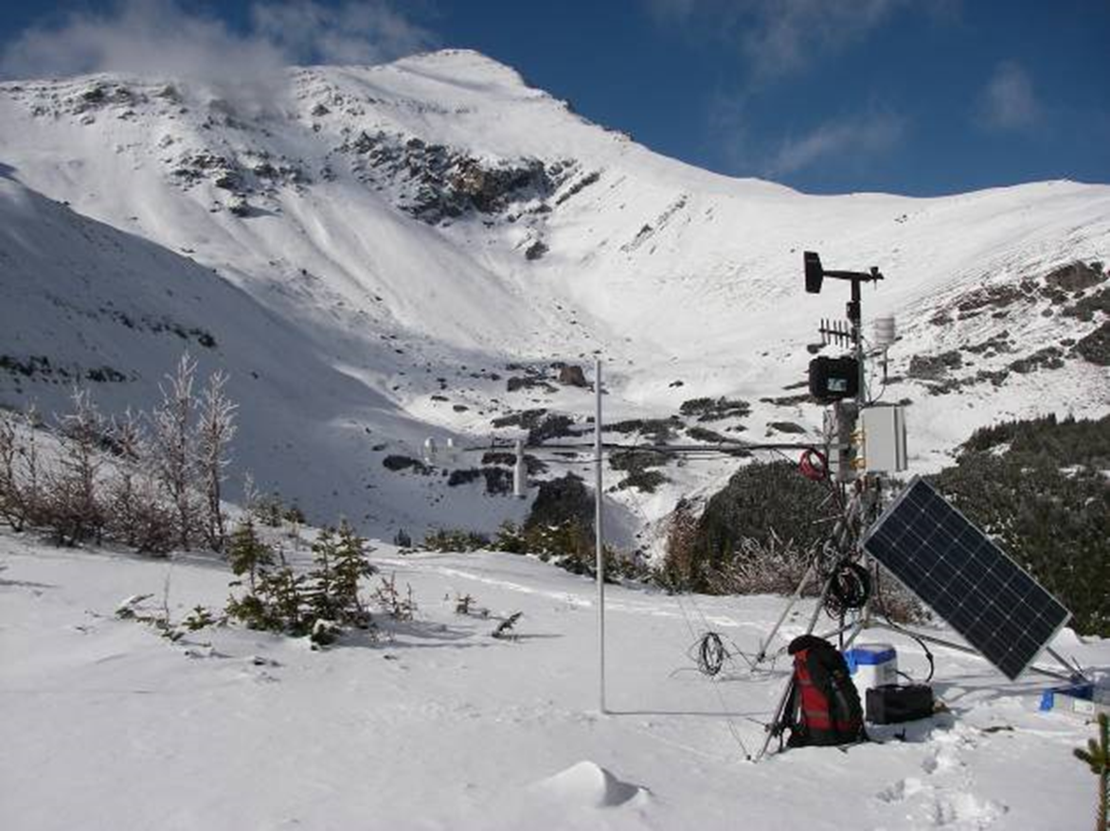
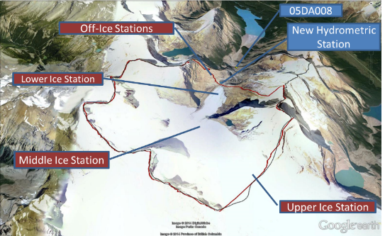
INARCH Objectives
To better
- understand alpine cold regions hydrological processes,
- improve their prediction,
- diagnose their sensitivities to global change
and
To find consistent measurement strategies.

Slide 3
INARCH Questions
How do varying mountain measurement standards affect scientific findings around the world?
What control does changing atmospheric dynamics have on the predictability, uncertainty and sensitivity of alpine catchment energy and water exchanges?
What improvements to alpine energy and water exchange predictability are possible through improved physics, downscaling, data collection and assimilation in models?
Do existing mountain model routines have a global validity?
How do transient changes in perennial snowpacks, glaciers, ground frost, soil stability, and vegetation impact alpine water and energy models?

Slide 4
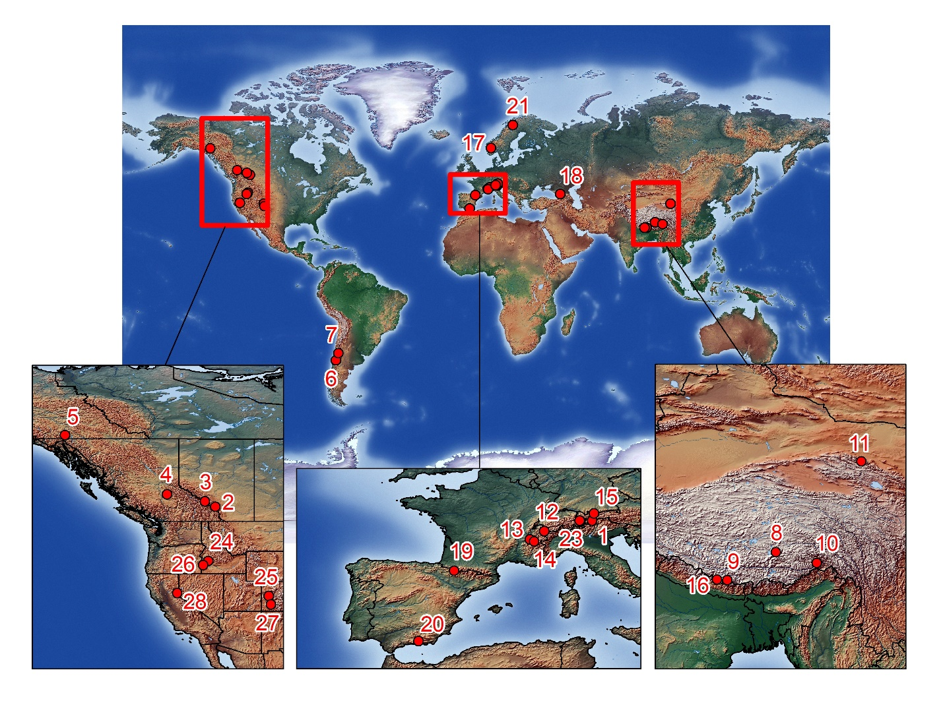
Germany: 15. Zugspitze Basin and Schneefernerhaus Research Station;
Nepal: 16. Langtang Catchment;
Norway: 17. Finse Alpine Research Centre;
Russia: 18. Djankuat Research Basin;
Spain: 19. Izas Research Basin; 20. Guadalfeo Monitoring Network;
Sweden: 21. Tarfala Research Catchment;
Switzerland: 22. Dischma Research Catchment; 23. Weissfluhjoch Snow Study Site;
USA: 24. Dry Creek Experimental Watershed; 25. Grand Mesa Study Site; 26. Reynolds Creek Experimental Watershed; 27. Senator Beck Basin Study Area; 28. Sagehen Creek, Sierra Nevada.
INARCH Research Basins
Austria: 1. Open Air Laboratory (OpAL);
Canada: Canadian Rockies Hydrological Observatory - 2. Marmot Creek Research Basin; 3. Peyto Glacier; 4. Quesnel River Research Basin; 5. Wolf Creek Research Basin;
Chile: 6. Upper Diguillín River Basin; 7. Upper Maipo River Basin;
China: 8. Nam Co Monitoring and Research Station for Multisphere Interactions; 9. Qomolangma Atmospheric and Environmental Observation and Research Station; 10. Southeast Tibet Observation and Research Station for the Alpine Environment; 11. Upper Heihe River Basin;
France: 12. Arve Catchement; 13. Col de Porte Experimental Site; 14. Col du Lac Blanc Experimental Site;

Slide 5
Data Requirements
Surface based data requirements for this project will primarily be met by:
openly-available detailed meteorological and hydrological observational archives from long-term research catchments at high temporal resolution (at least 5 years of continuous data with hourly sampling intervals for meteorological data, daily precipitation and streamflow, and regular snow and/or glacier mass balance surveys) in selected heavily instrumented alpine regions
atmospheric model reanalyses
downscaled climate model as well as regional climate model outputs

Slide 6
Data Requirements
The ideal is for sites to be Integrated Alpine Observing and Predicting Systems (IAOPS). A provisional classification scheme for IAOPS is:
CLASS A: sites receiving technology transfer and developing towards CLASS B to E
CLASS B: Single measurement points with highly accurate driving data and snow or glacier data
CLASS C: gauged catchments that contain Class B sites and detailed vegetation coverage, soils, topography, snowcovered area, glacier mass balance or permafrost information
CLASS D: domains for which high resolution gridded meteorological data is available that includes CLASS C sites CLASS E: the same as CLASS D but gridded meteorological data is also available as climate change scenarios.

Slide 7
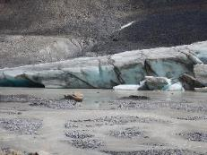
Linkages
GEWEX GHP Projects
Cold/Shoulder Season Precipitation Near 0ºC project
Changing Cold Regions Network and Global Water Futures
Western US RHP & Water for Foodbaskets
Global Cryosphere Watch
WMO-SPICE and WMO High Mountain Summit
TPE (Third Pole Environment)
Future Earth, Sustainable Water Futures Programme (SWFP)
International Commission for Snow and Ice Hydrology (IUGG)
UNESCO-International Hydrological Programme efforts on climate change impacts on snow, glacier and water resources within the framework of IHP-VIII (2014-2021) ‘Water Security: Responses to Local Regional and Global Challenges’.

Slide 8
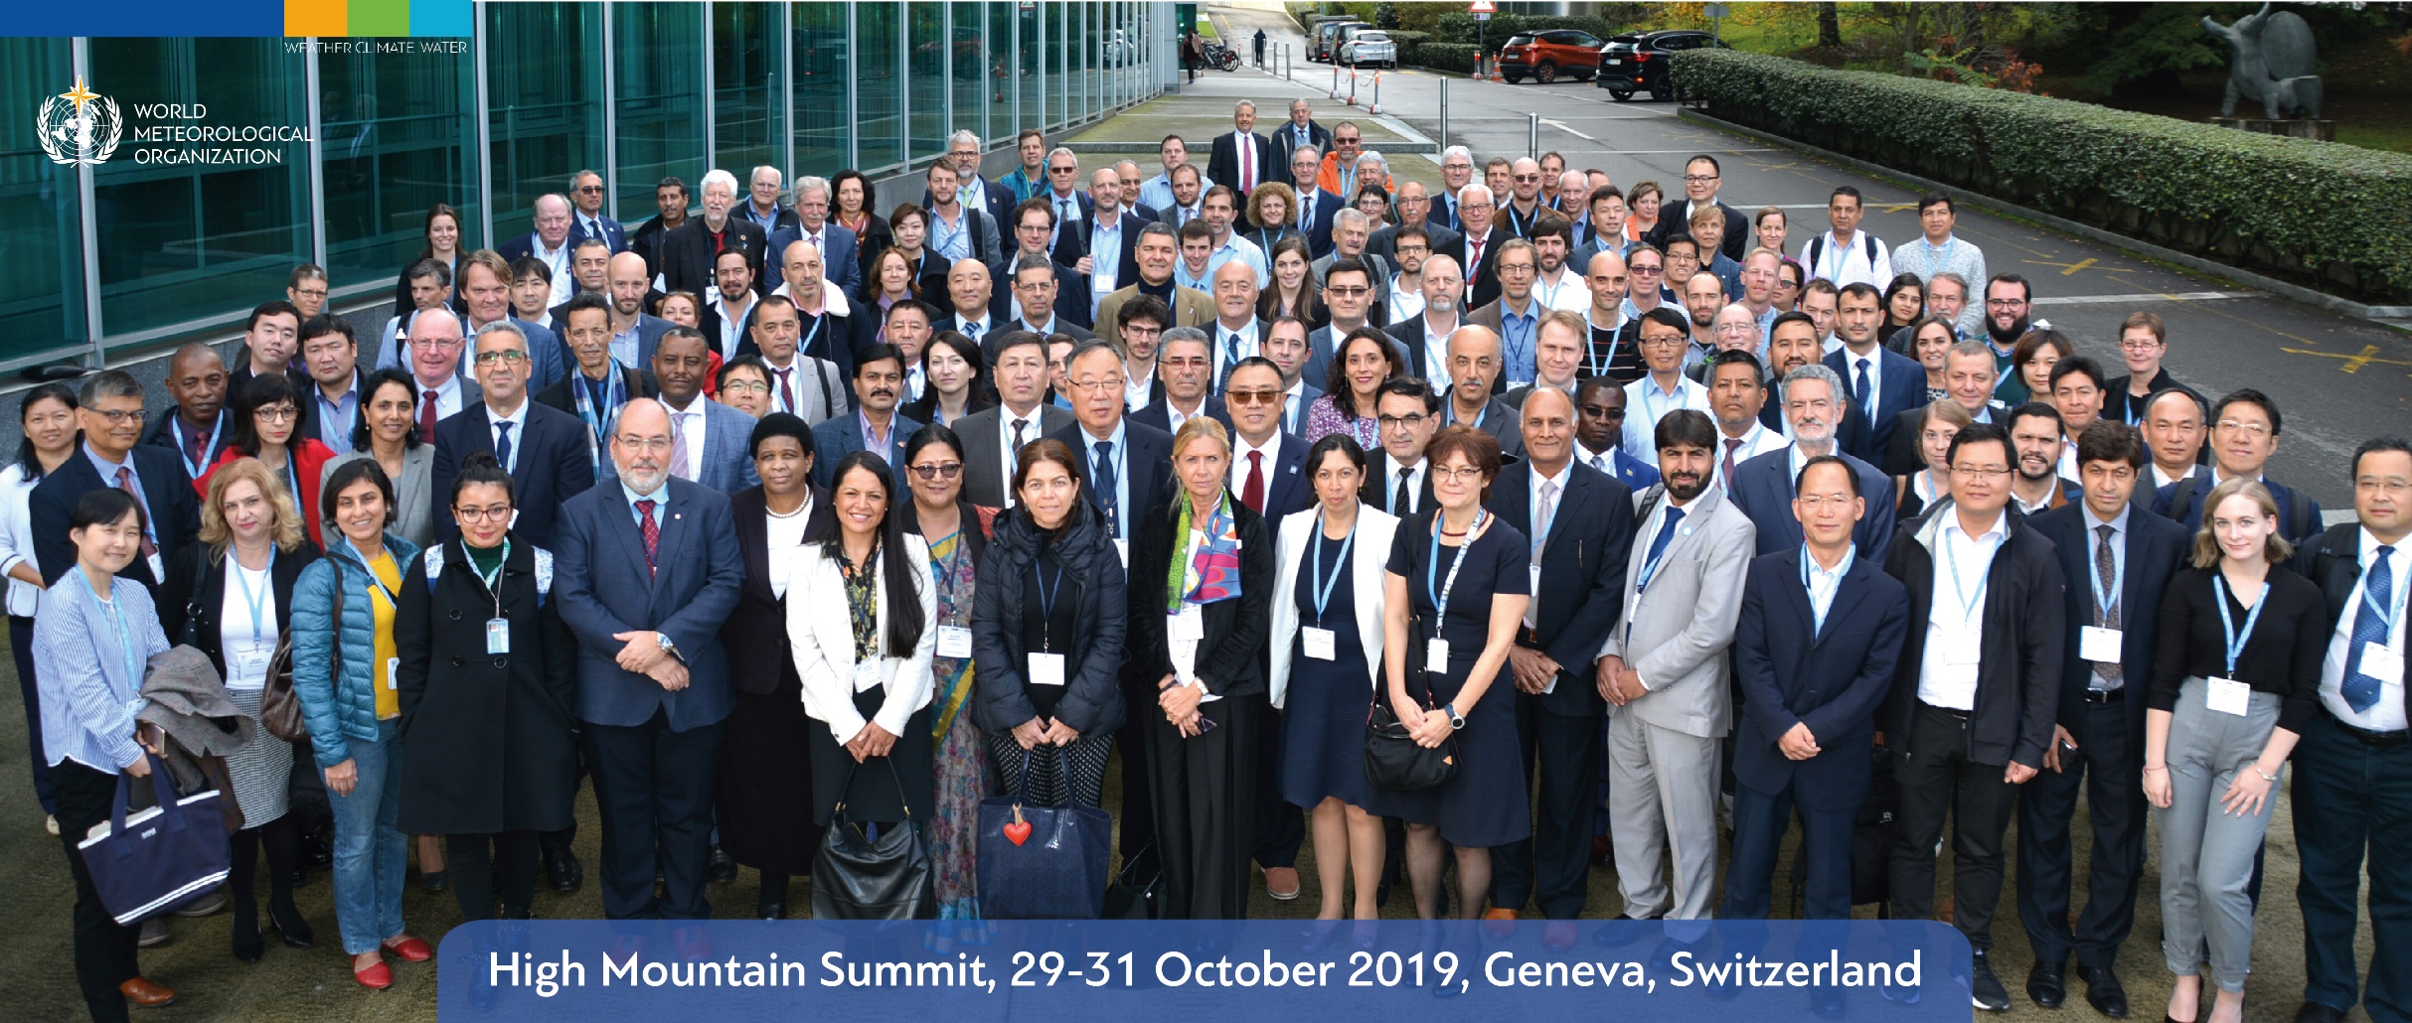
WMO High Mountain Summit
The World Meteorological Organization (WMO) convened the High Mountain Summit from 29 to 31 October 2019 at its headquarters in Geneva, Switzerland. The Summit was concluded with a Call to Action which includes a roadmap to science-based, user-driven knowledge and information systems supporting sustainable development and risk reduction in mountain and downstream regions.

Slide 9
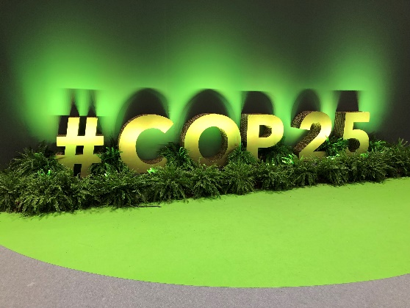
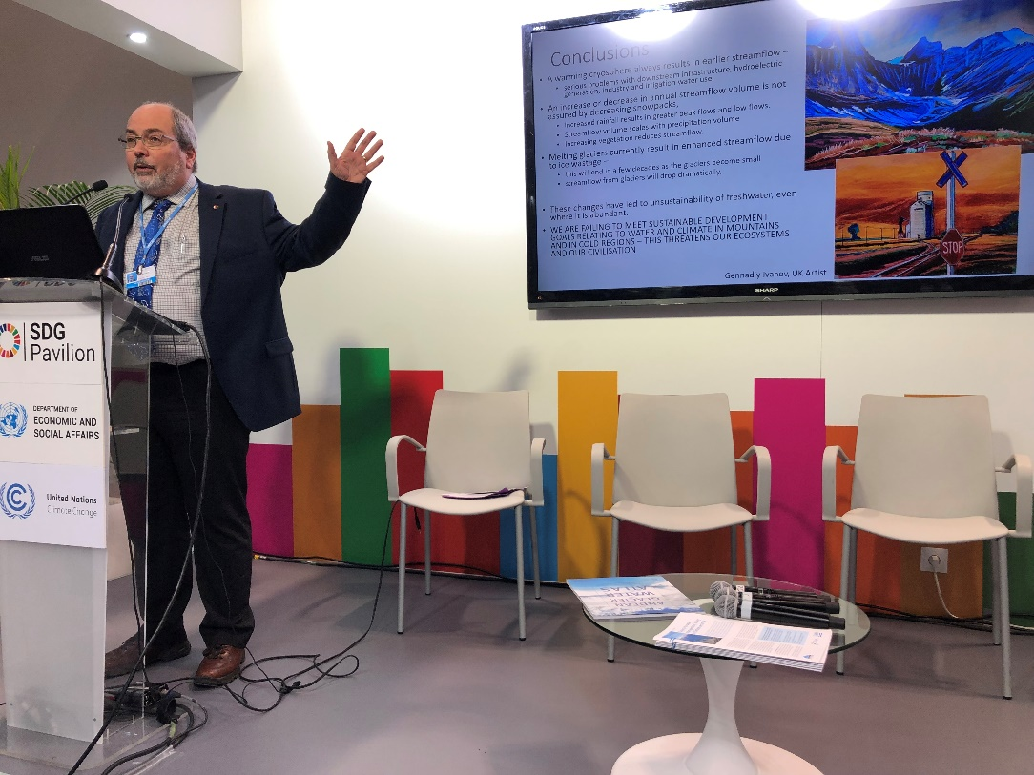
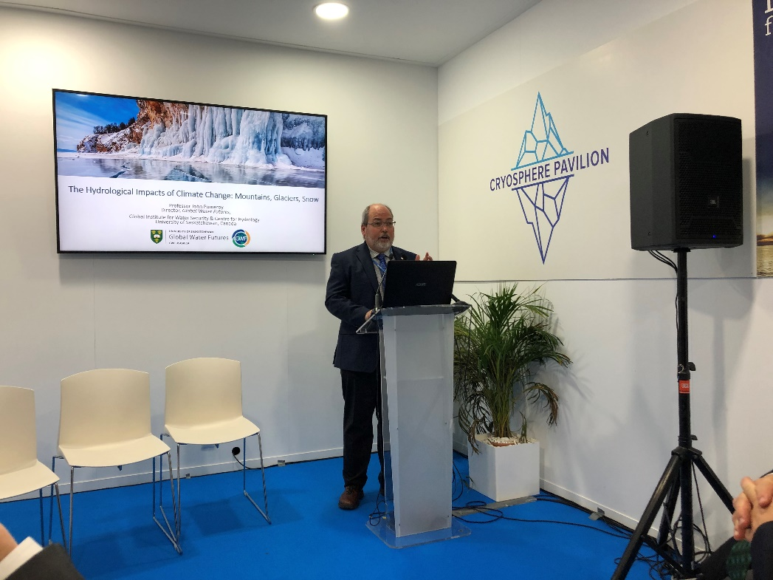
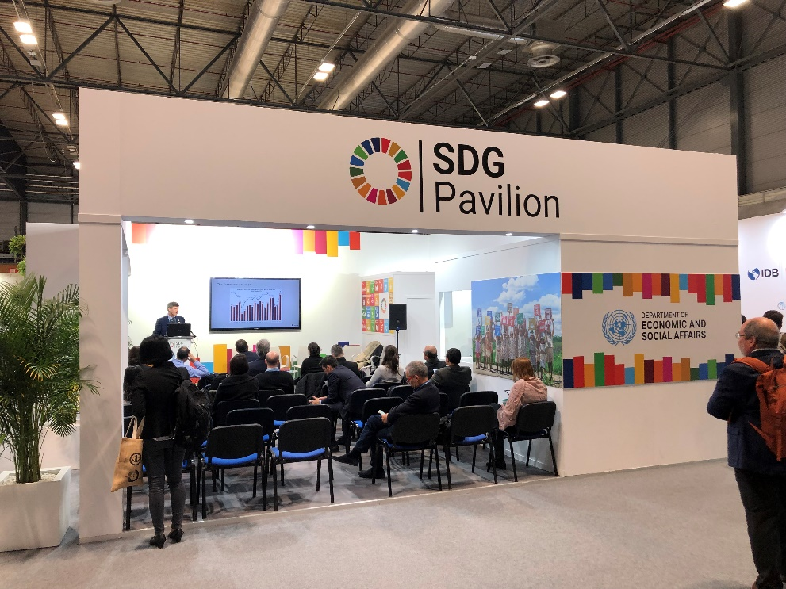
United Nations Climate Change Conference, COP25
INARCH Chair, John Pomeroy, was invited by WMO to attend the United Nations Climate Change Conference, COP25, as an Observer and to make two presentations on climate change and water in relation to the Sustainable Development Goals and to the Changing Cryosphere in Madrid, Spain in December 2019.
https://news.usask.ca/media-release-pages/2019/the-world-is-losing-its-cool-with-the-loss-of-snowpacks-and-glaciers,-posing-threats-to-water-security.php

Slide 10
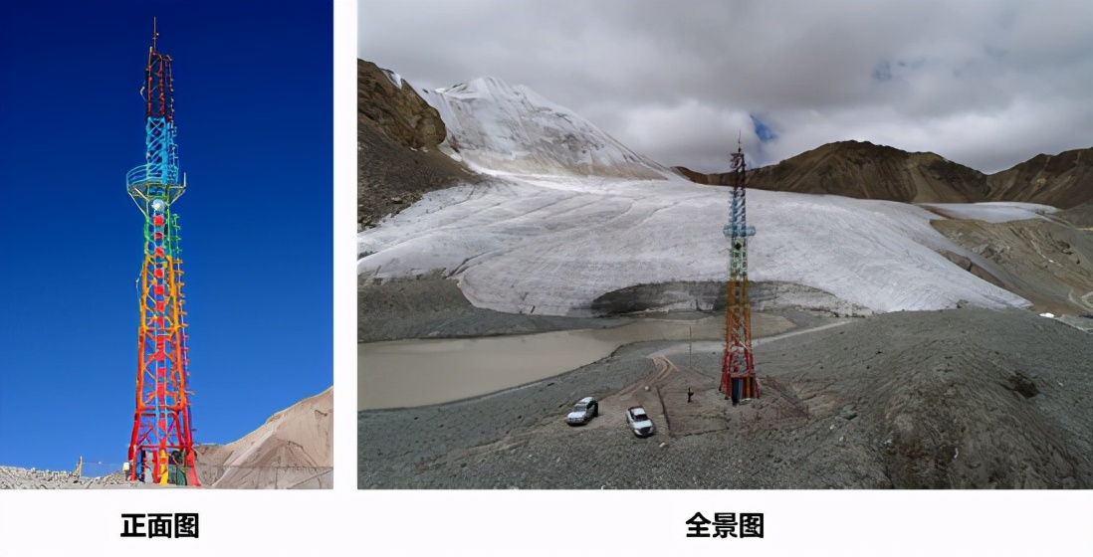
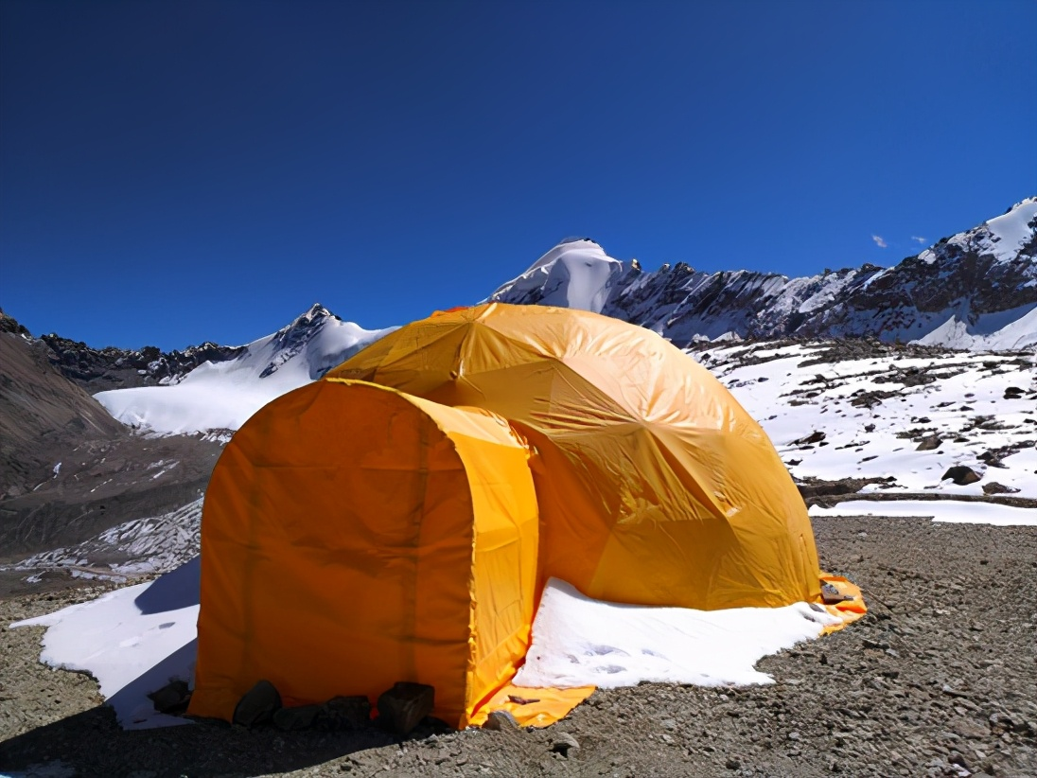
Institute of Tibetan Plateau Research, Chinese Academy of Sciences
Scientific activities in 2020:
PBL tower measurements over the Kuoqionggangri glacier
5 layers of air temperature, air humidity, wind speed and direction;
four component radiation and rain gauge;
automatic weather station;
ice temperature profiles and ice movement measurements;

Slide 11
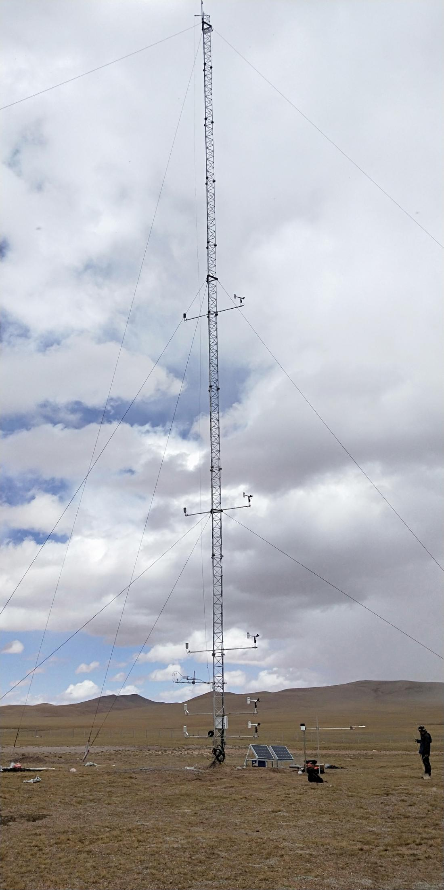
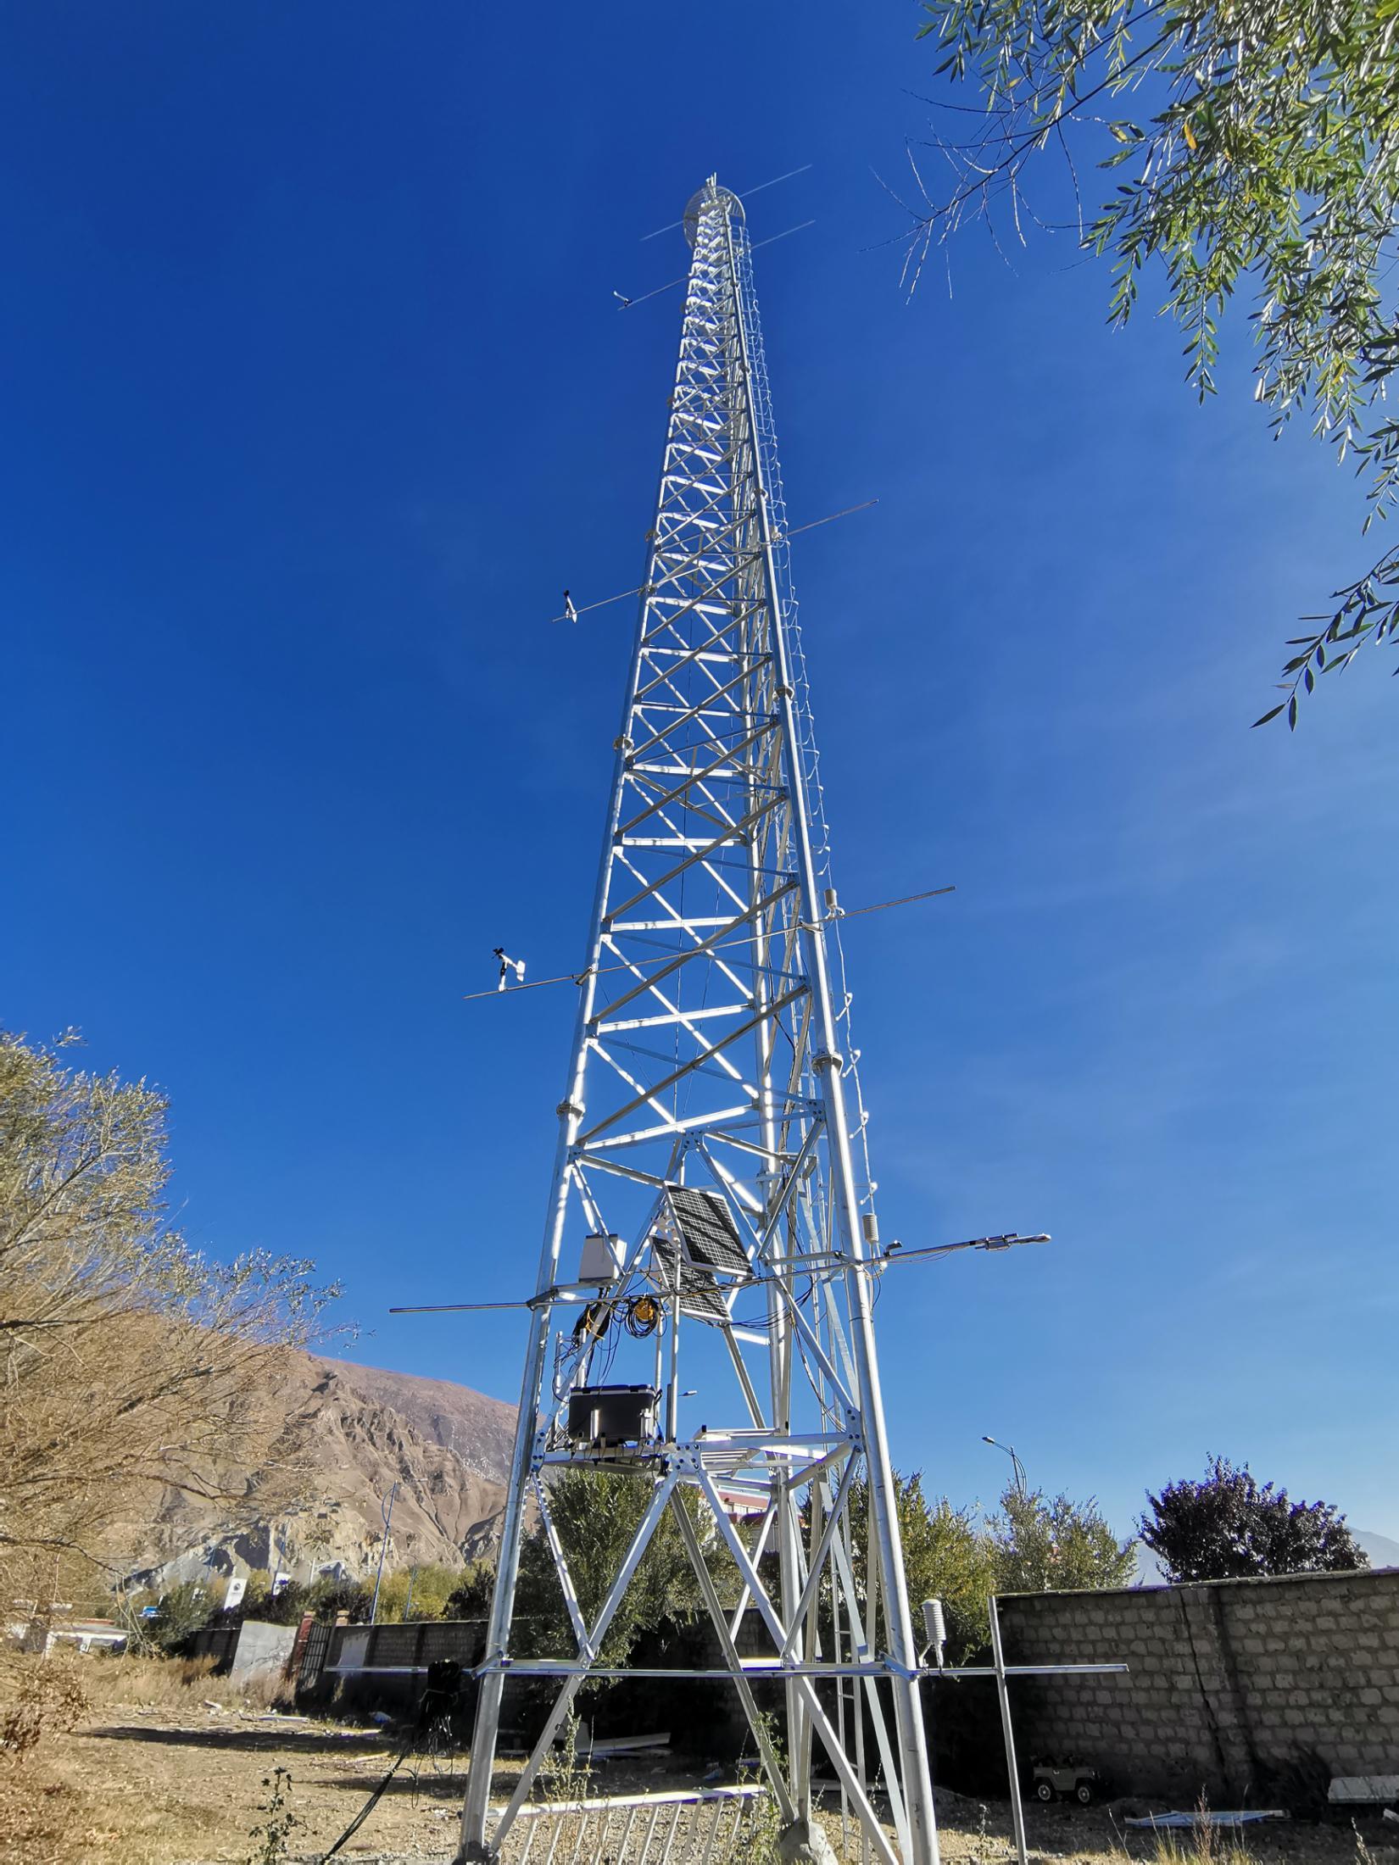
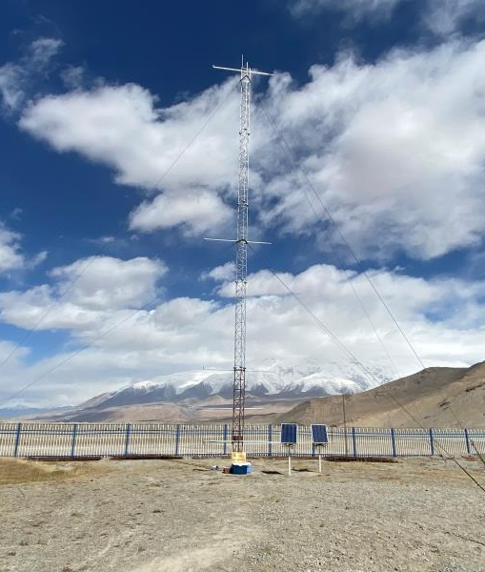
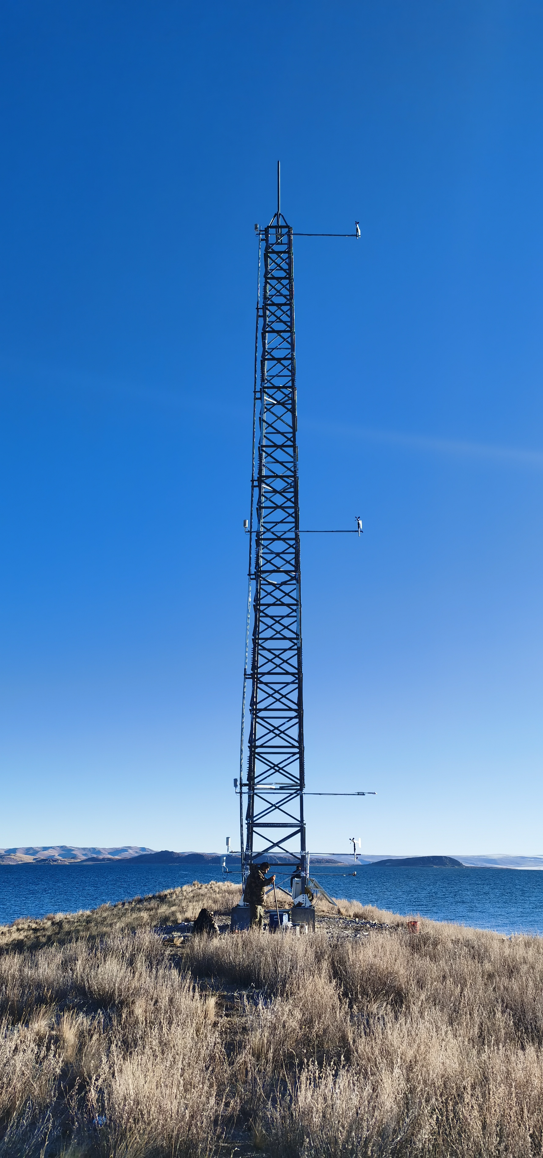
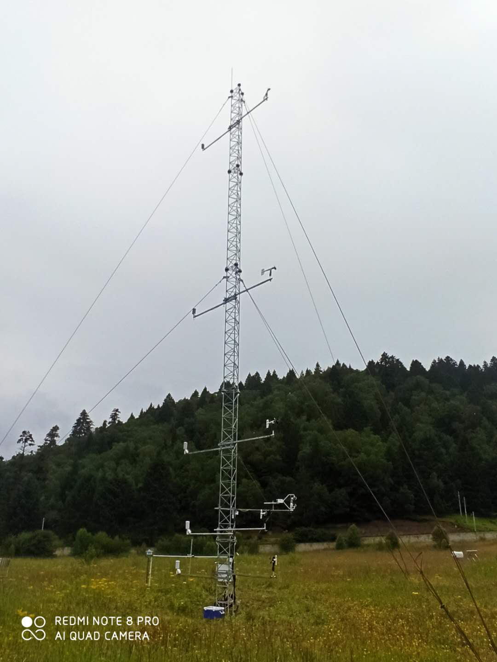
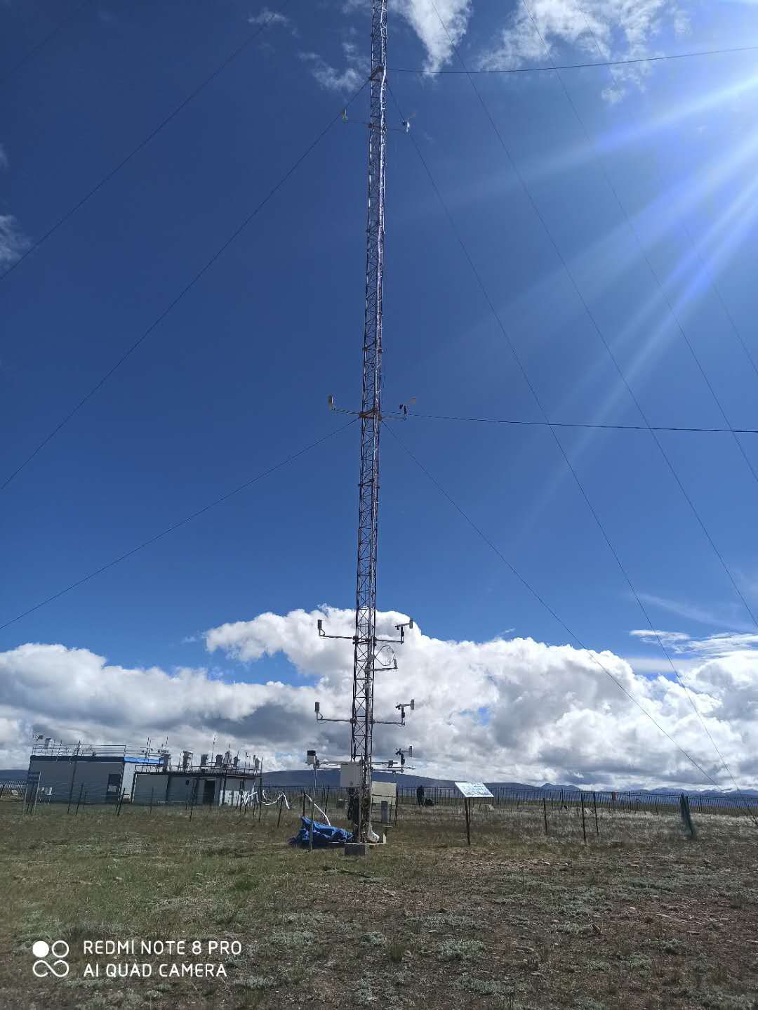
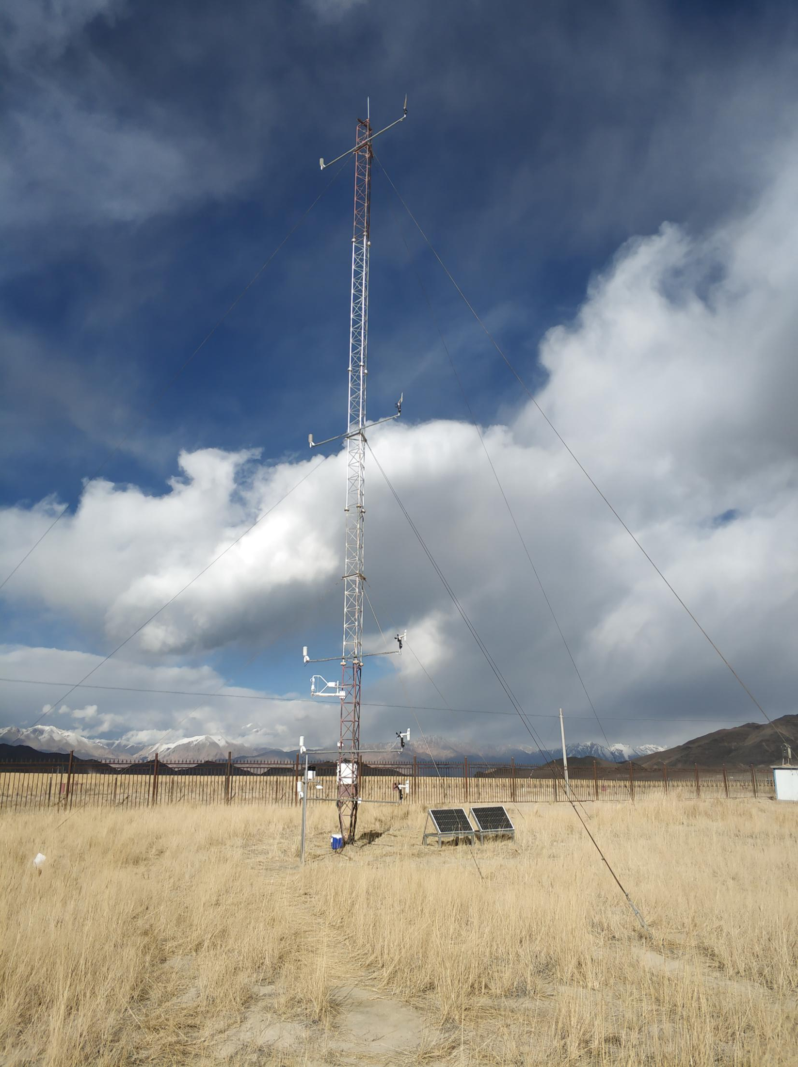
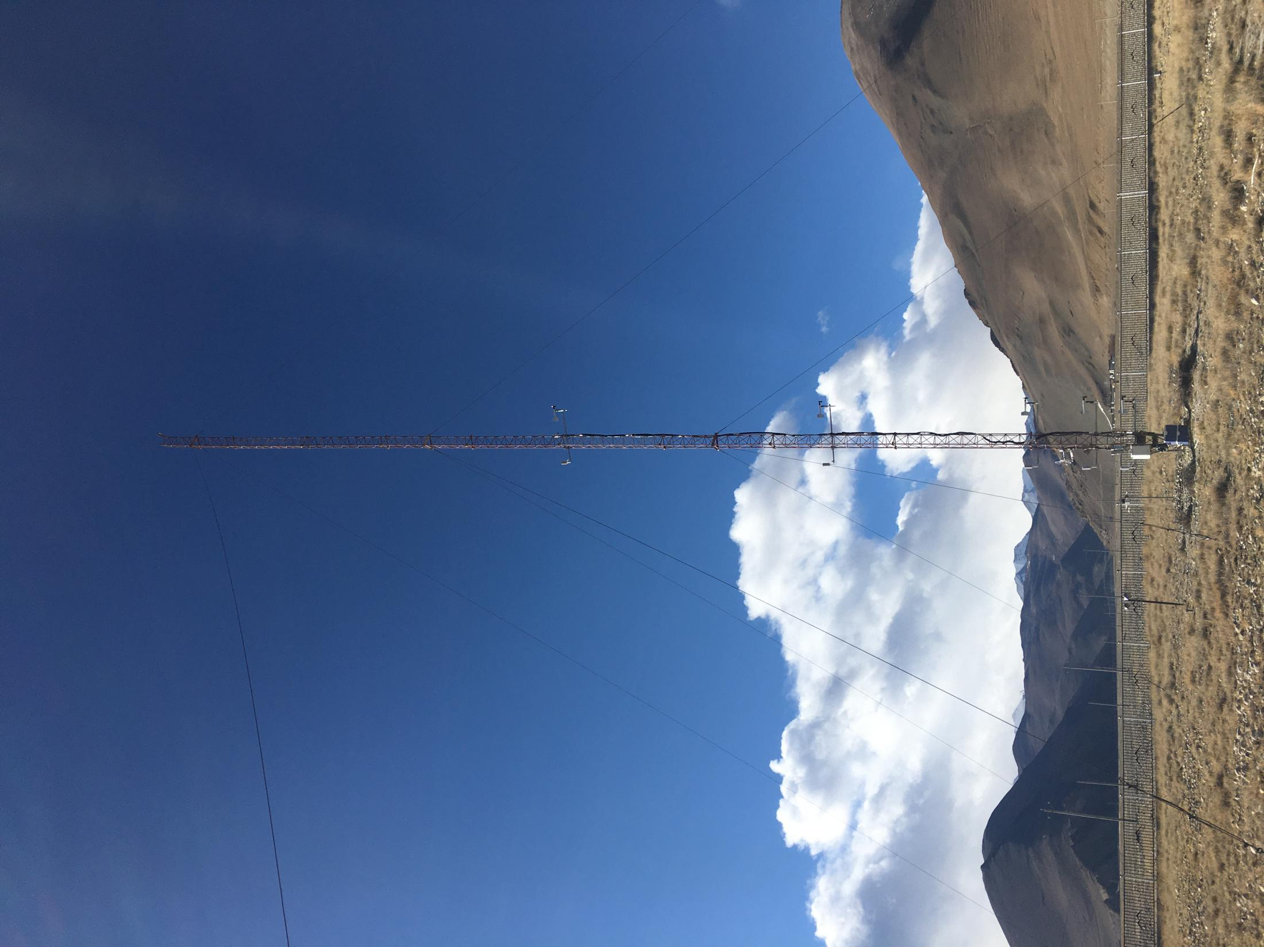
Institute of Tibetan Plateau Research, Chinese Academy of Sciences
Scientific activities in 2020:
8 land-atmosphere interaction systems updated with new sensors
Shunghu Station
Lhasa Campus
Muztagh Ata Station
(MAWORS)
Island in Namco Lake
Nagri Station
(NASDE)
Linzhi Station (SETS)
Namco Station
(NAMORS)
Mt.Qomolangma Station (QOMS)

Slide 12
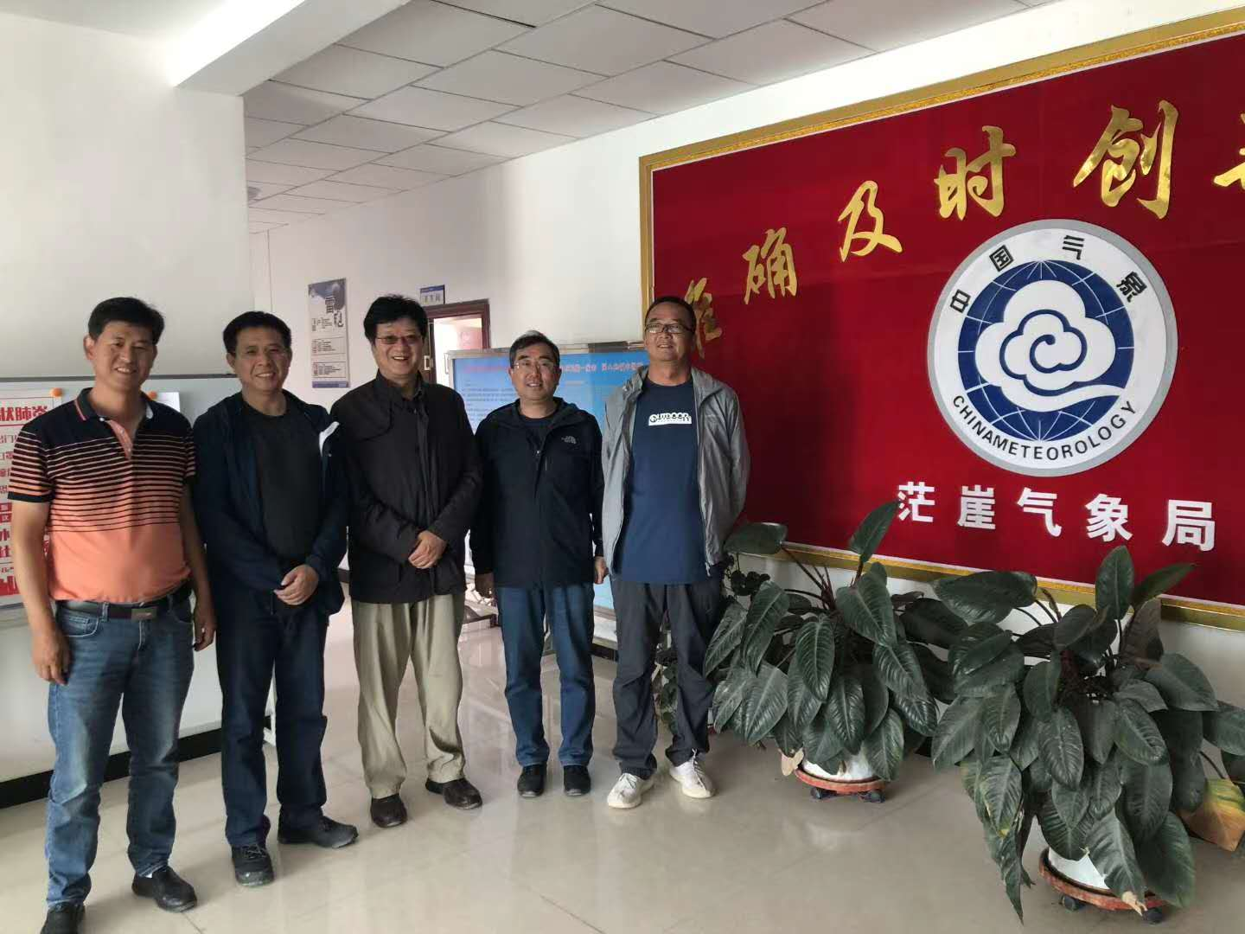
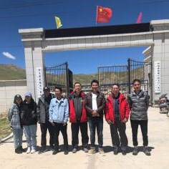
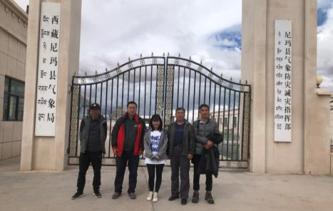
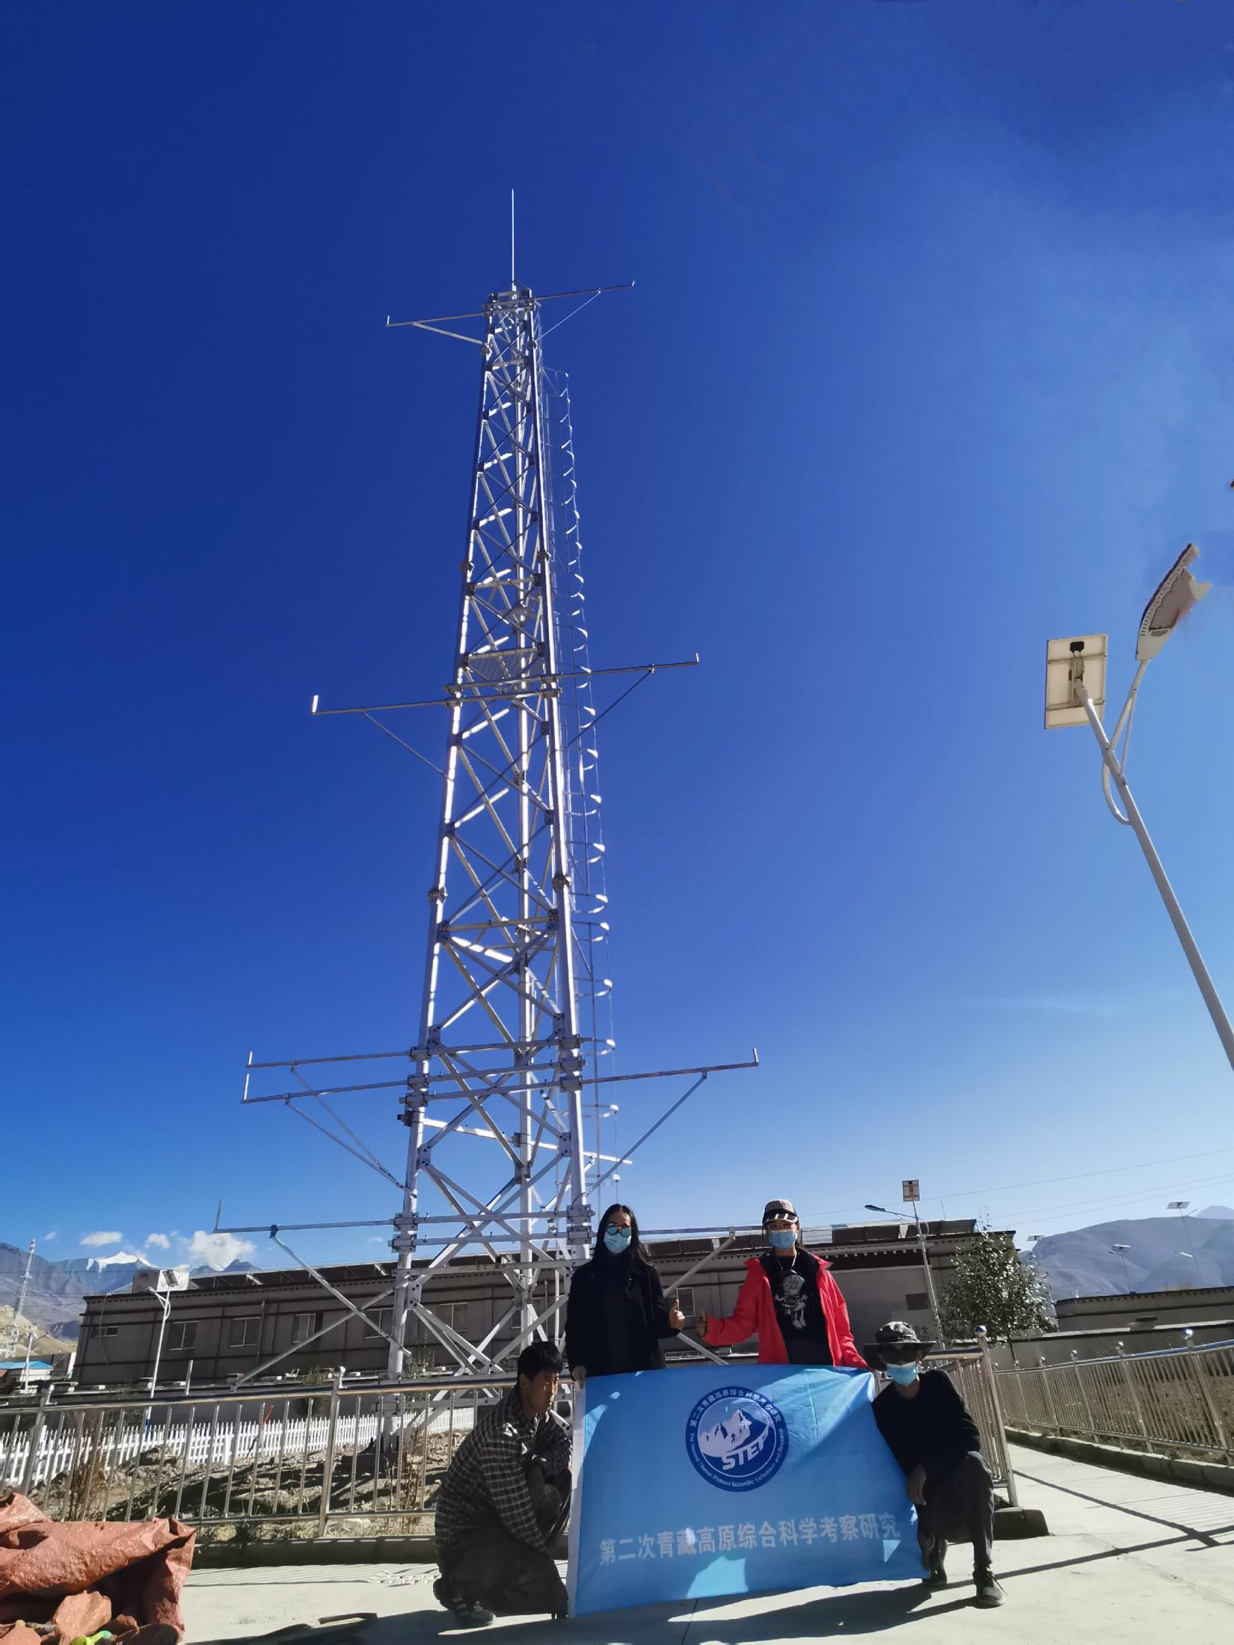
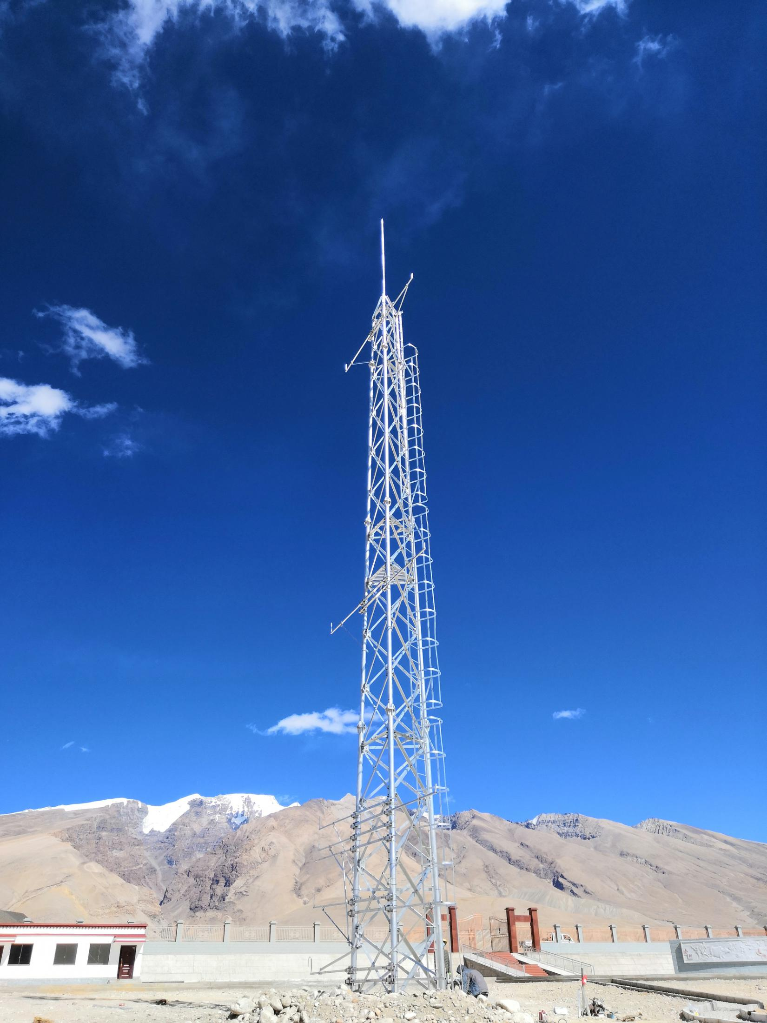
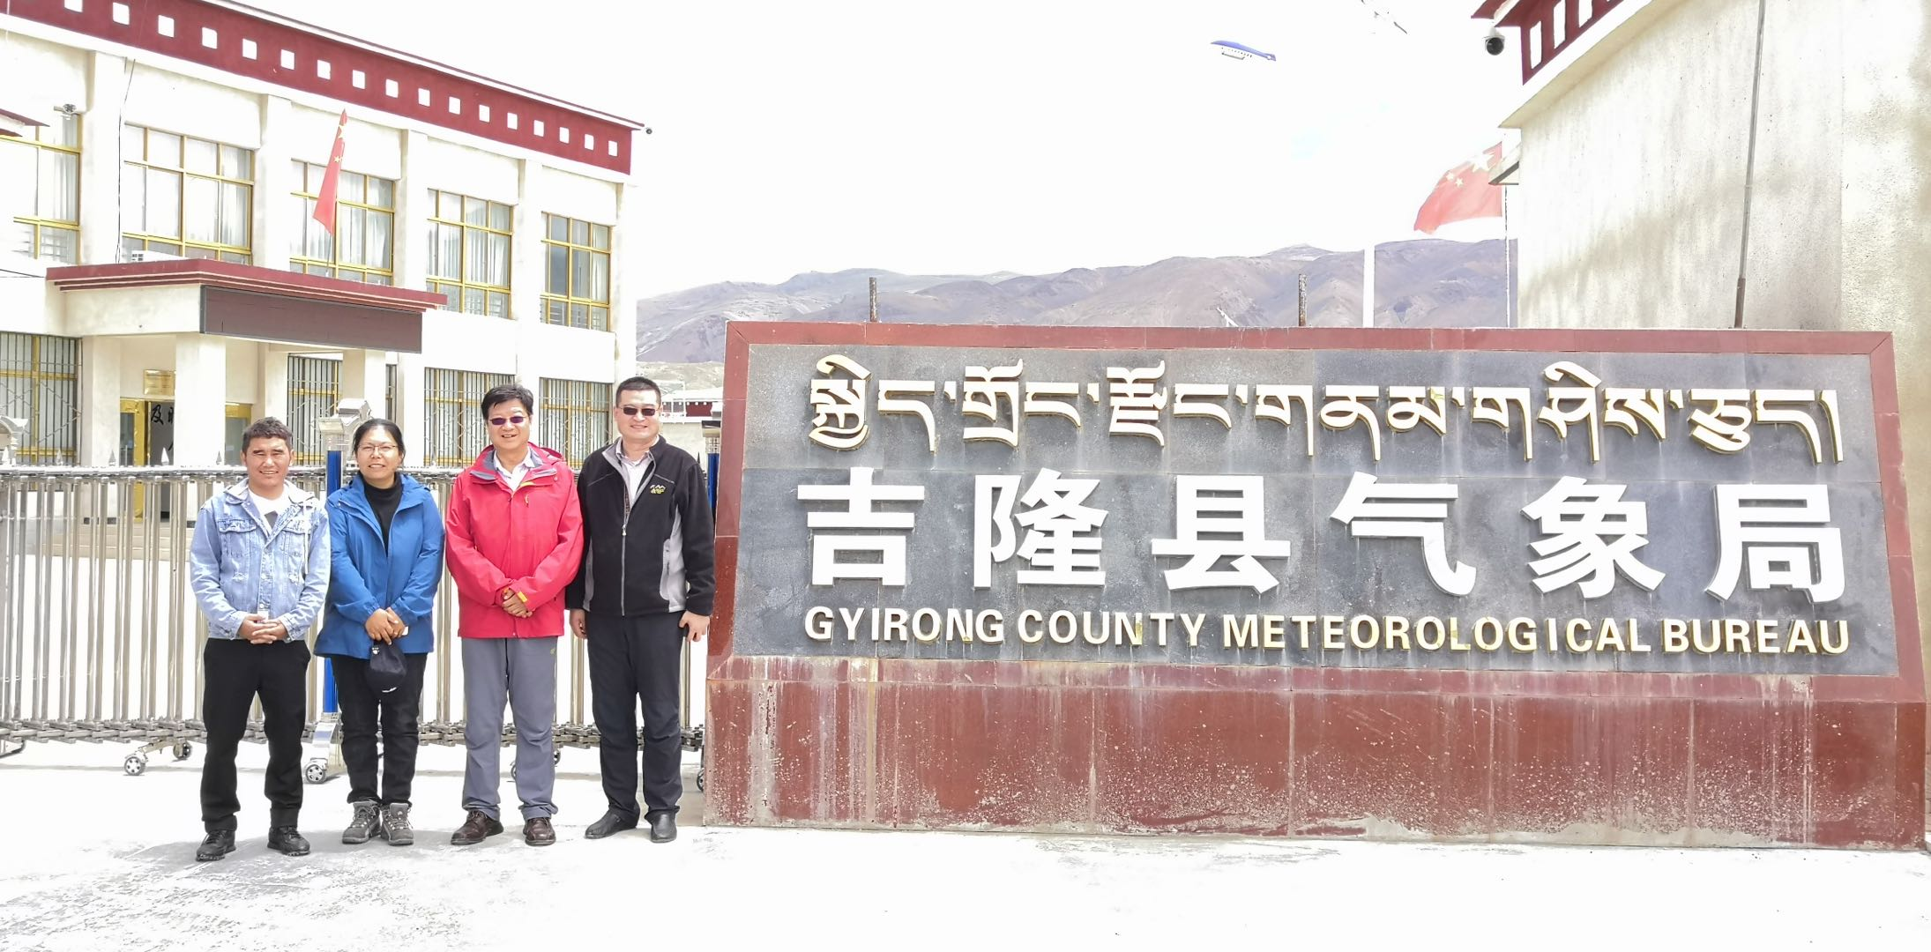
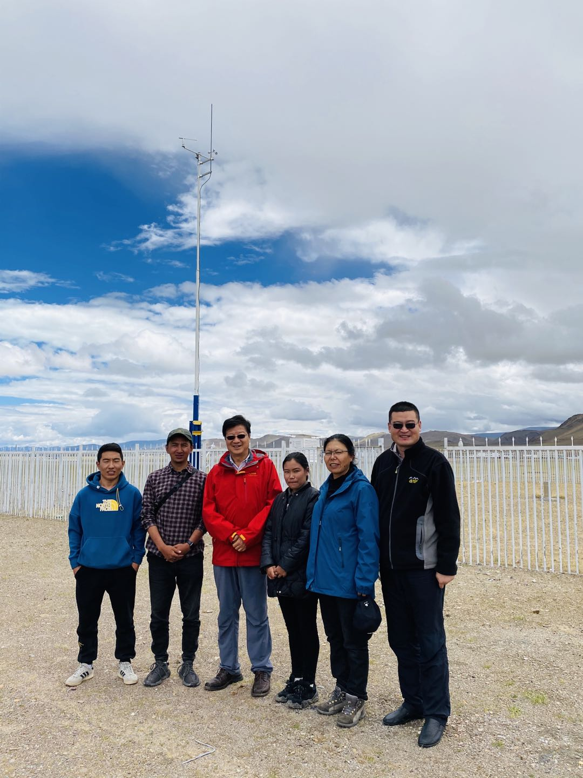
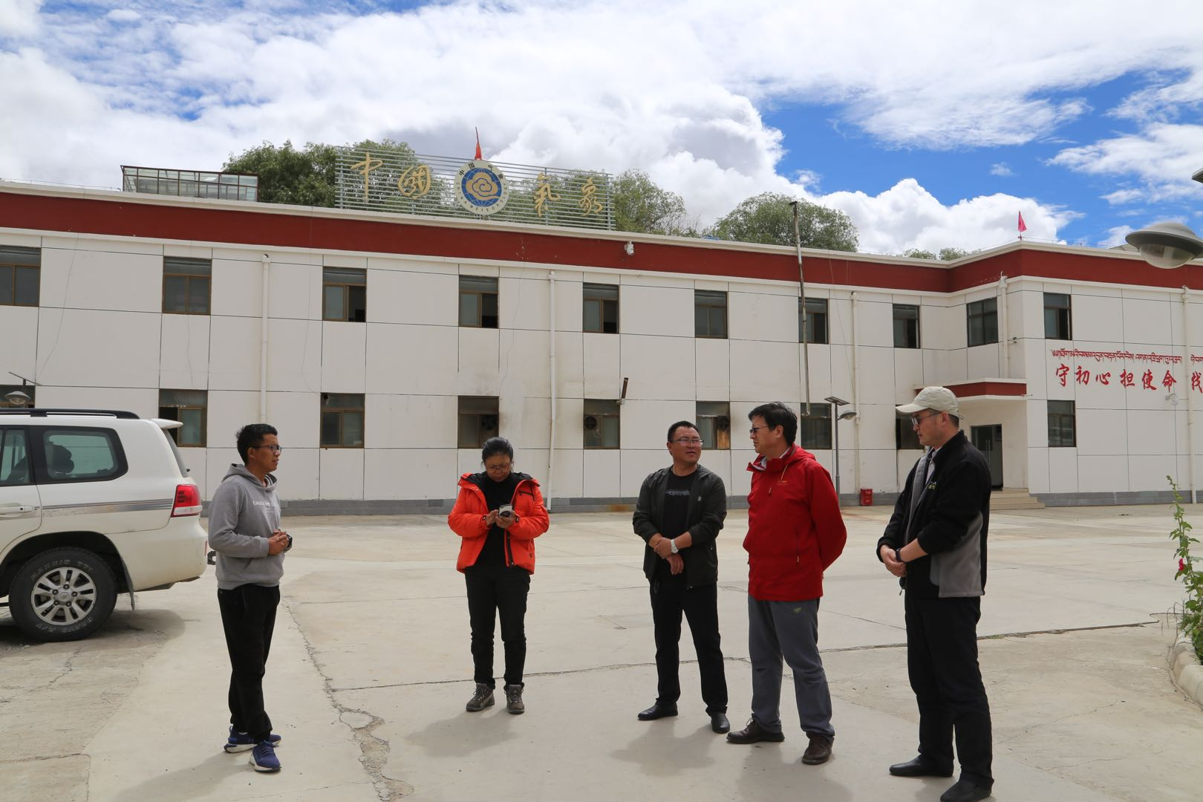
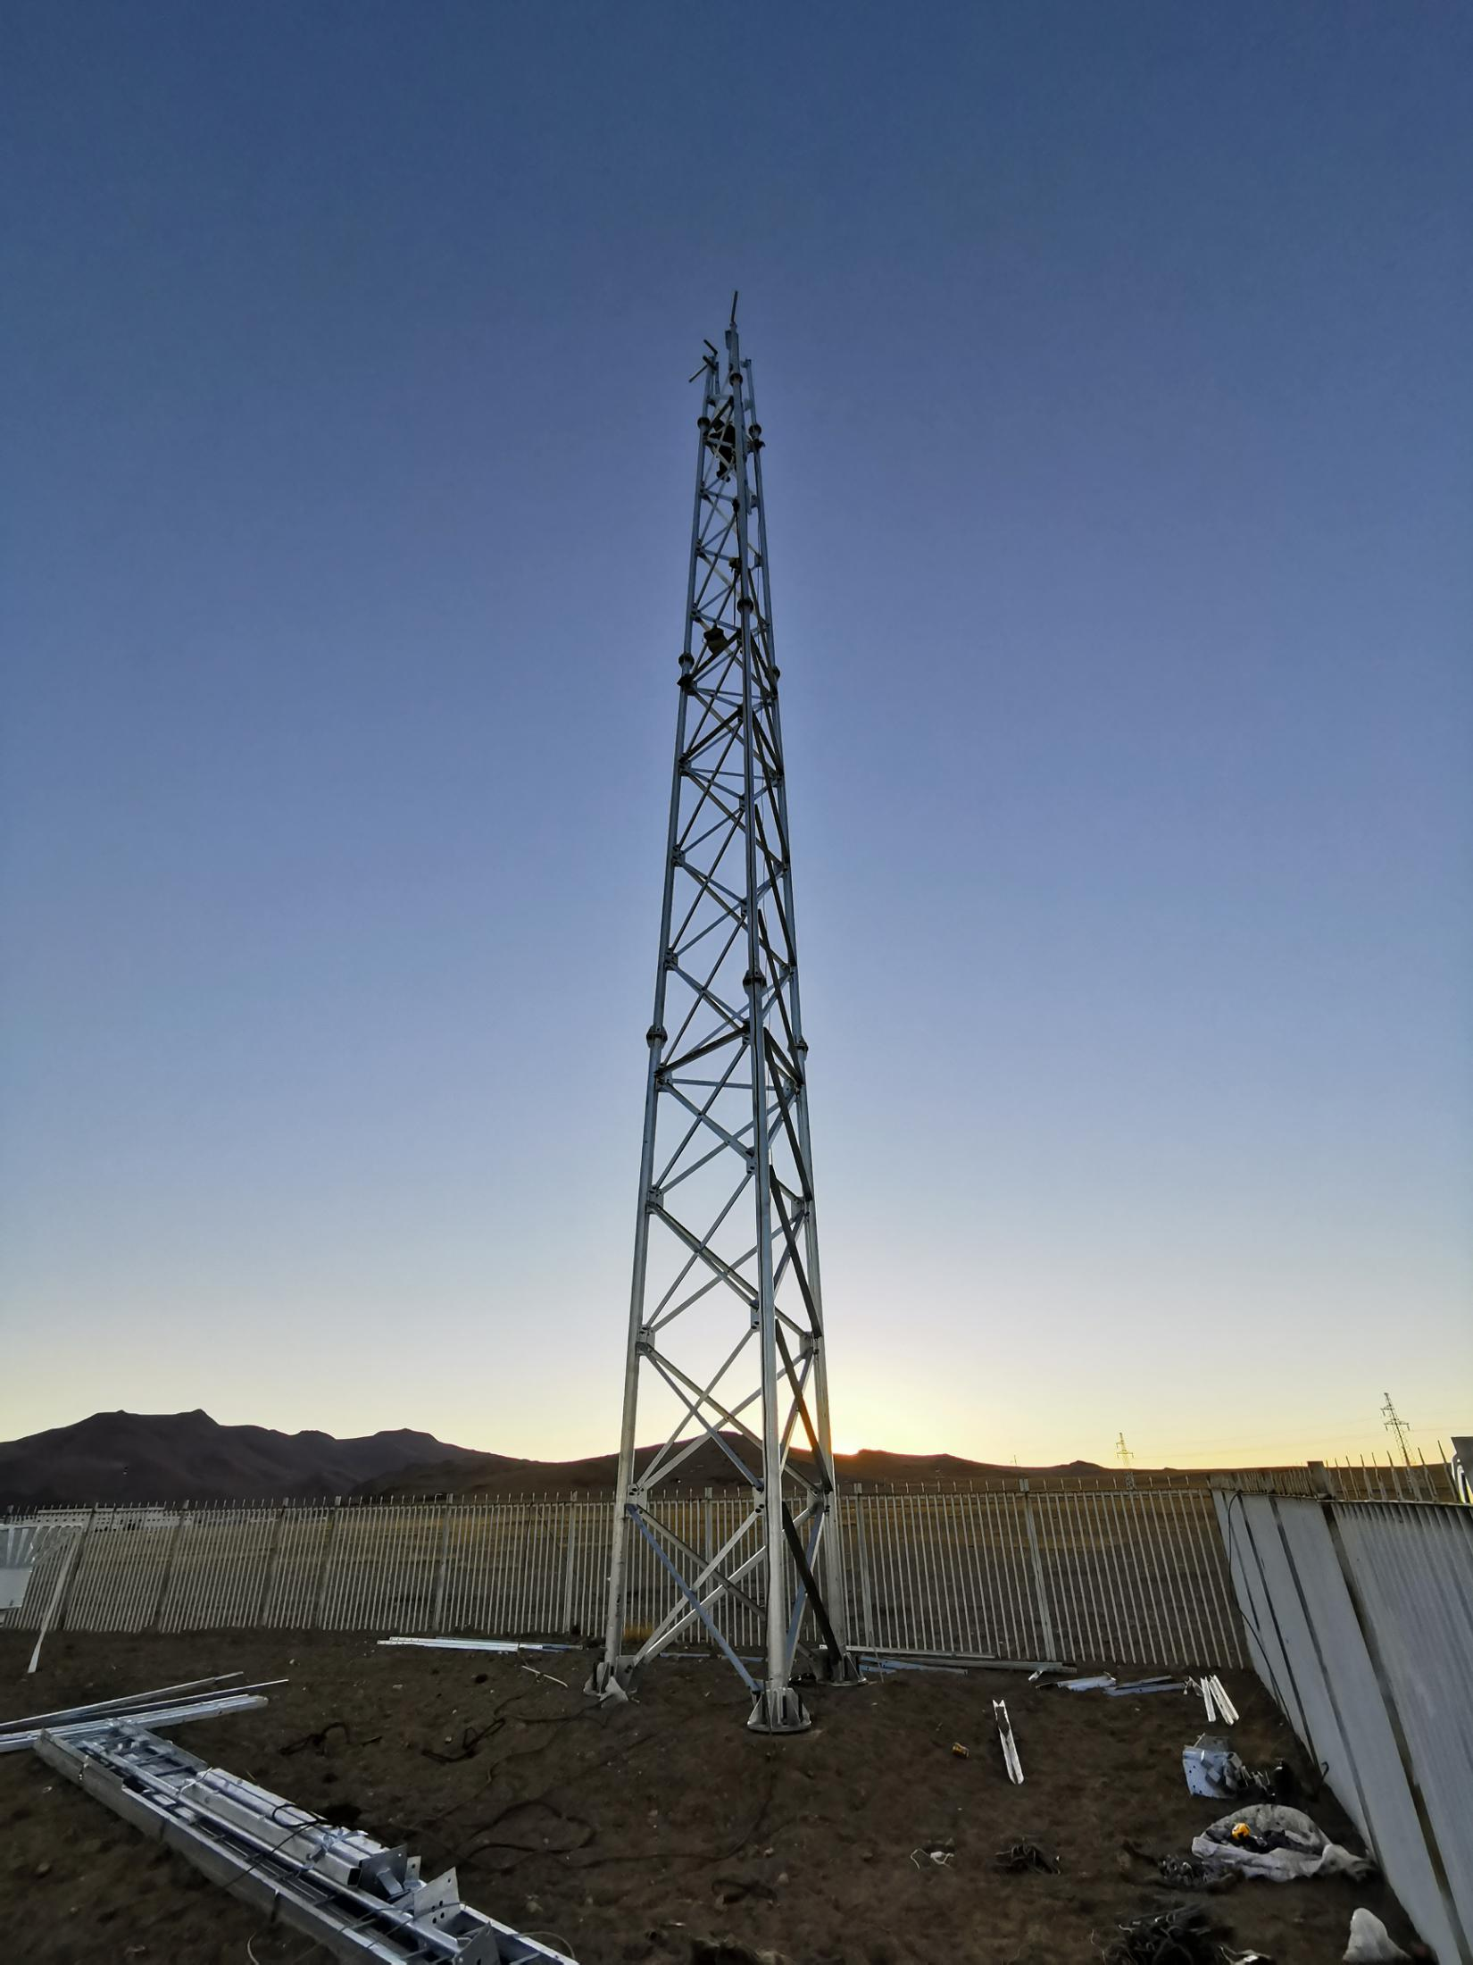
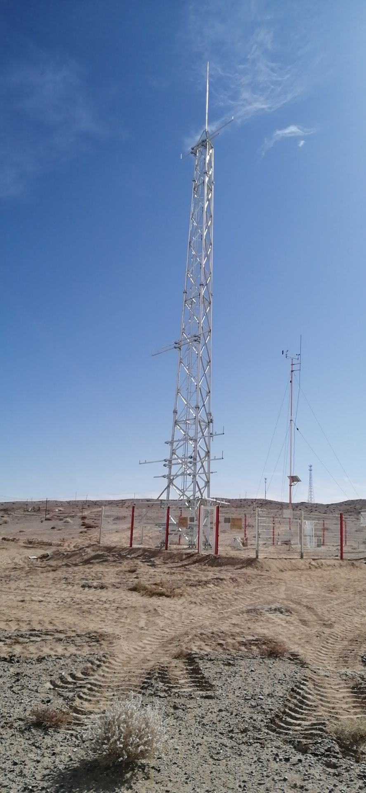
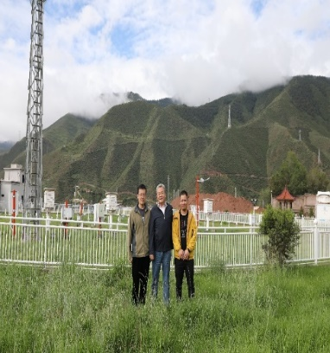
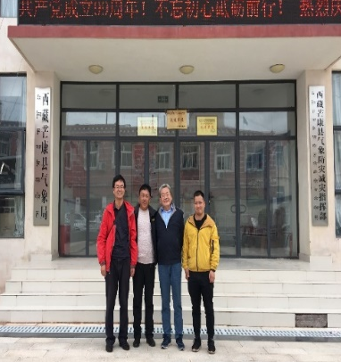
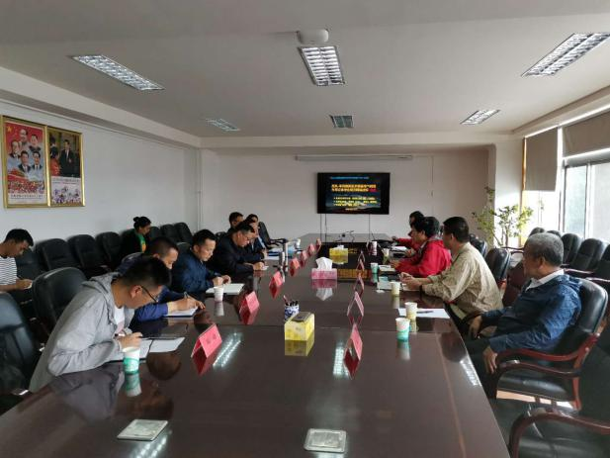
Institute of Tibetan Plateau Research, Chinese Academy of Sciences
Scientific activities in 2020:
9 new land-atmosphere interaction measuring systems are being installed
Mangai
Baingoin
Nyima
Gyirong
Burong
Gyirong
Coqen
Burong
Coqen
Mang Ai
Qamdo
Mangkam
Lhasa

Slide 13
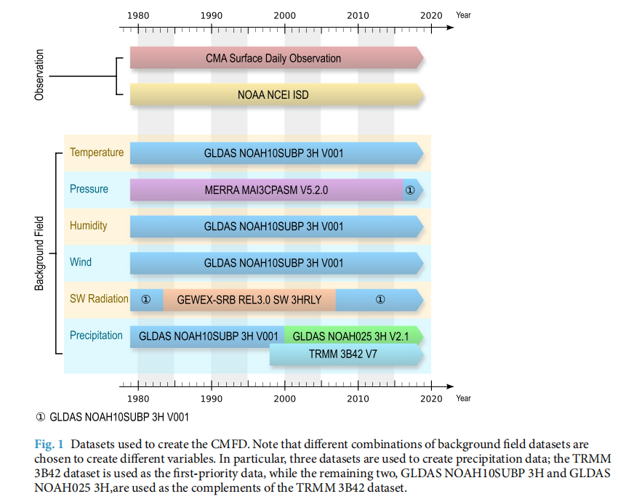
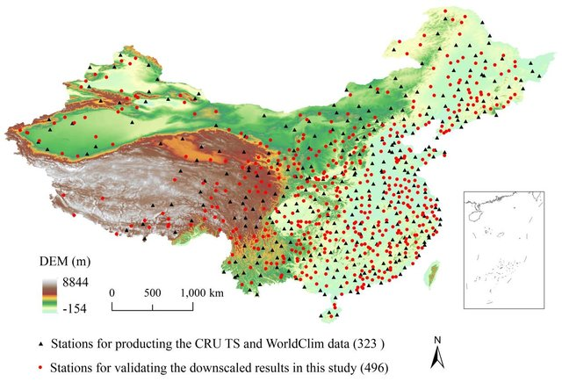
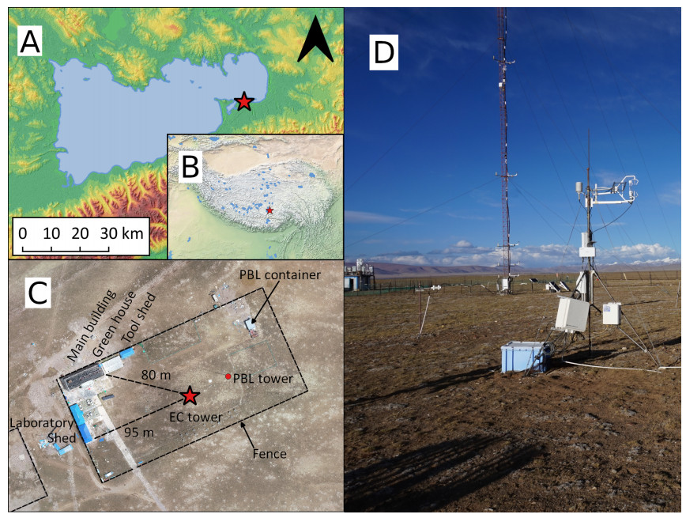
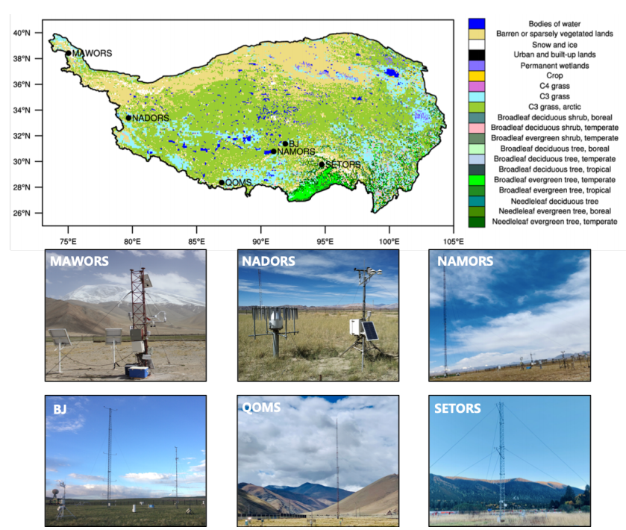
ITP/CAS Published Datasets
"China Meteorological Forcing Dataset"
"New Downscaled 1901-2017 Climate Dataset"
He, J., K. Yang, W. Tang, H. Lu, J. Qin, Y. Chen, and X. Li, 2020: The first high-resolution meteorological forcing dataset for land process studies over China. Scientific Data, 7, 25.
Peng, S., Y. Ding, W. Liu, and Z. Li, 2019: monthly temperature and precipitation dataset for China from 1901 to 2017. Earth Syst. Sci. Data, 11, 1931-1946.
"long term CO₂ and H₂O dataset"
"Integrated 2005-2016 in-situ observation datasets
Nieberding, F., C. Wille, G. Fratini, M. Asmussen, Y. Wang, Y. Ma*, and T. Sachs, 2020: A Long Term (2005–2019) Eddy Covariance Data Set of CO2 and H2O Fluxes from the Tibetan Alpine Steppe, Earth Syst. Sci. Data.
Ma Yaoming, and coauthors, 2020: A long-term (2005–2016) dataset of integrated land–atmosphere interaction observations on the Tibetan Plateau, Earth Syst. Sci. Data

Slide 14
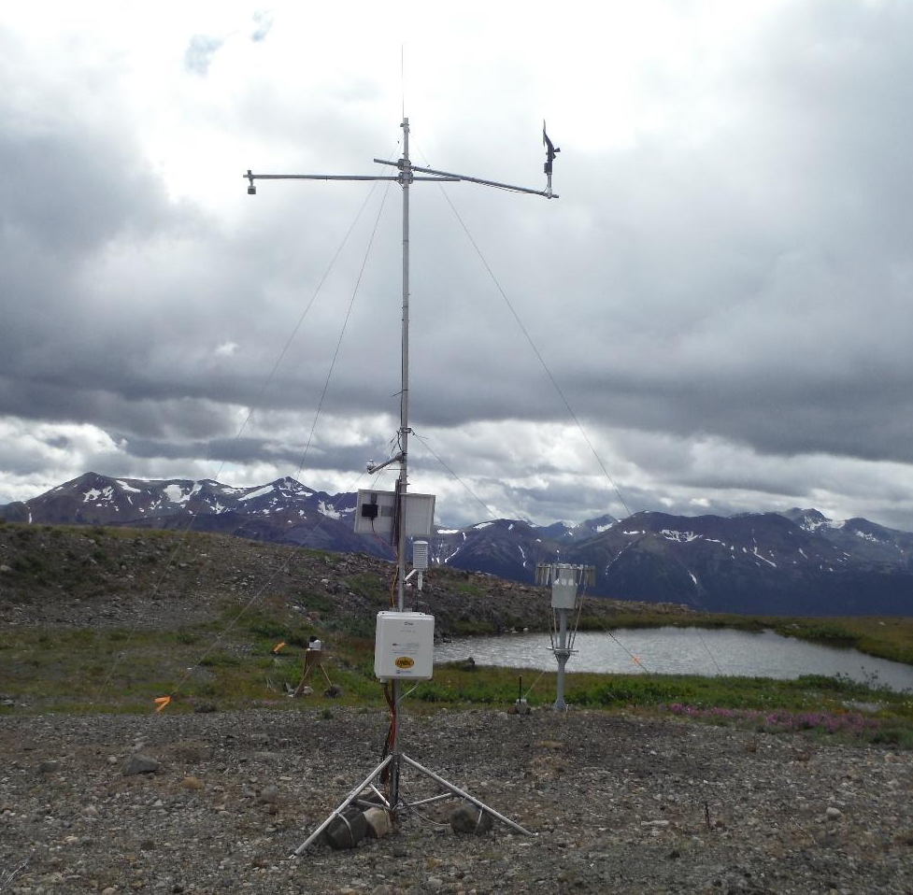
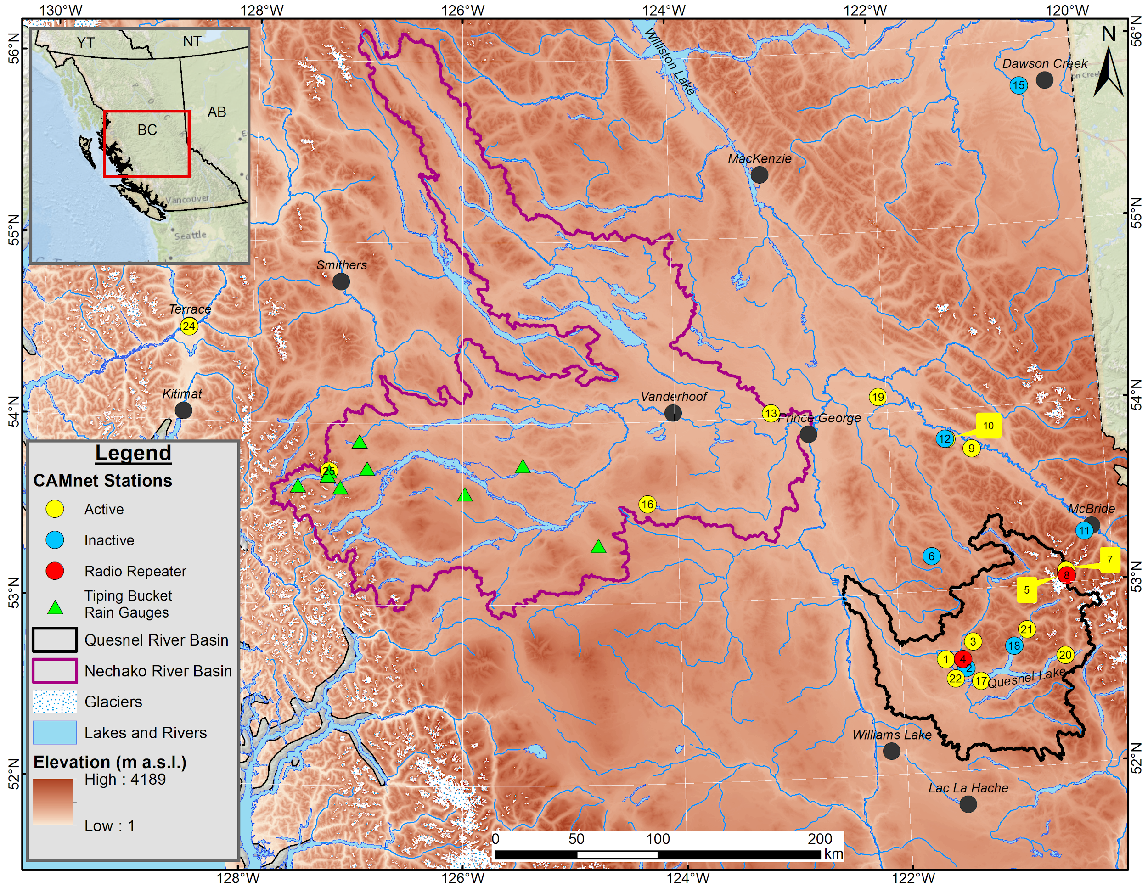
Quesnel and Nechako Watershed developments, Cariboo Mountains, Canada
Cariboo Alpine Mesonet (CAMnet)
Above: Mount Sweeney weather station located in the Nechako Watershed
Left: Map of north-central BC showing the CAMnet weather stations and tipping bucket rain gauges in the Nechako and Quesnel Watersheds
Notes:
In recent years, the Cariboo Alpine Mesonet (CAMnet) has expanded to the 47,234 km² Nechako and 12,191 km² Quesnel watersheds, in northern British Columbia (BC), Canada, to form a network of 15 active weather stations and nine precipitation gauges as of October 2020. The stations are deployed in valley and mountain settings at elevations ranging from 70 m to 2105 m a.s.l. along a longitudinal transect from the Coast Mountains, onto the Interior Plateau, then into the Cariboo Mountains. CAMnet spans a vast area across north central BC’s region in complex terrain comprising glaciers, lakes, rivers, reservoirs, and a multitude of landcover and vegetation types. The parameters typically measured at CAMnet weather stations include air temperature and relative humidity, wind speed and direction, atmospheric pressure, snow depth, precipitation, and soil temperature at 15 minute intervals.

Slide 15
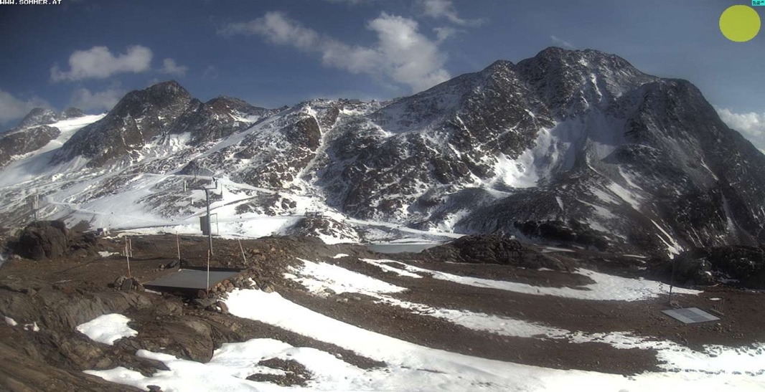
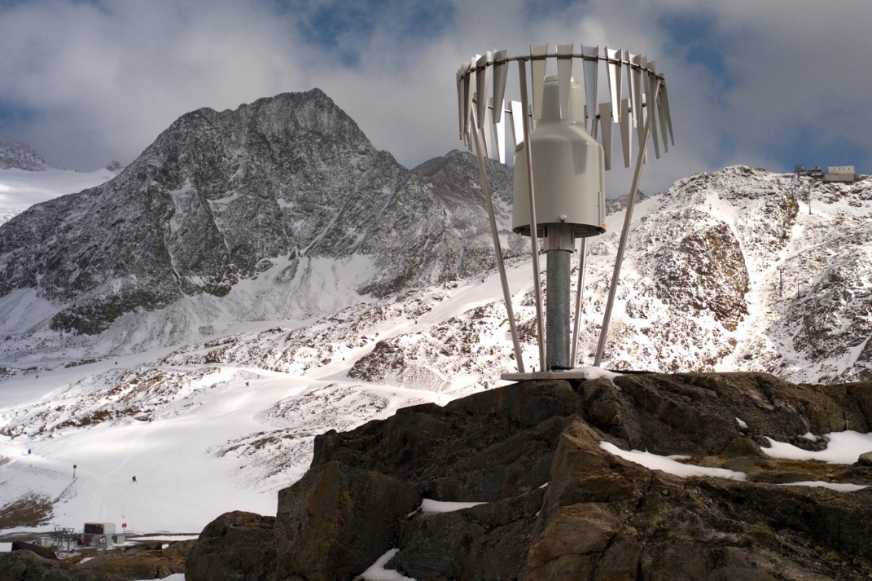
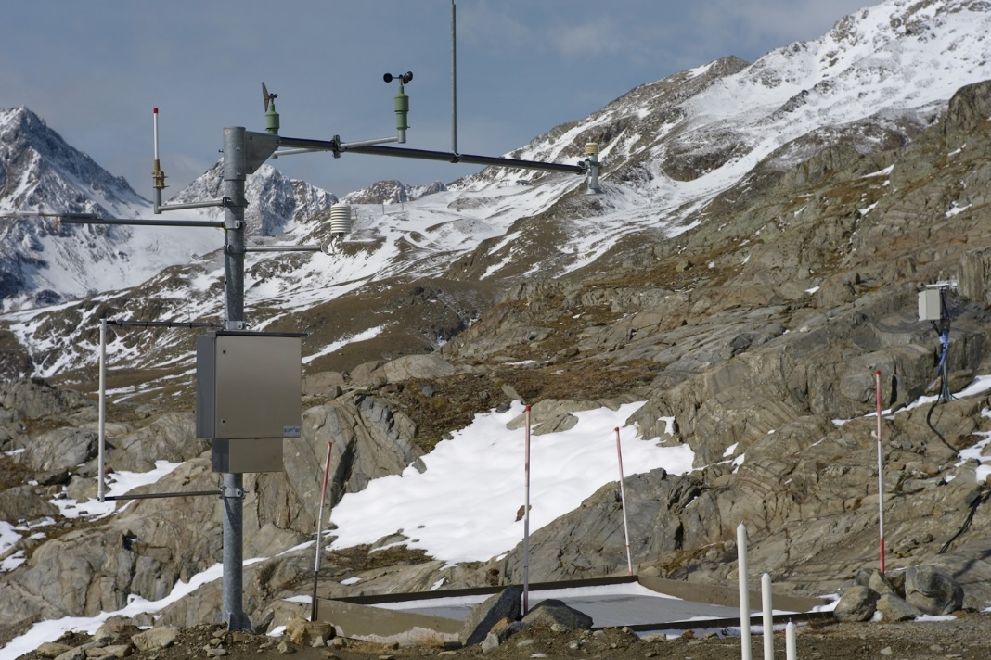
University of Innsbruck: Research team Human-environment systems research / Alpine Hydroclimatology (Prof. Ulrich Strasser, Dr. Michael Warscher)
Installation Bella Vista (2805 m a.s.l.) (webcam image 01.10.2020 15:00 CET)
Rainfall gauge at Bella Vista (2805 m a.s.l.)
New installations in the Rofental High Alpine Research Basin, Ötztal Alps, Austria
Acoustic snow drift sensor and highest snow pillow in the European Alps at Bella Vista (2805 m a.s.l.)
Notes:
Bella Vista station (2805 m a.s.l.): a new snow scale with ultrasonic snow depth sensor that allows - together with the snow pillow/ultrasonic arrangement at the main station upslope - to track lateral snow redistribution events, like the one on Dec 28 2019 that caused a deathly avalanche in the adjacent skiing area slope (see press news). Both the upper and the lower installation are approximately 25 m apart from each other; one is frequently registering snow erosion, the other its deposition. Both sites are now equipped with the same snow temperature profile sensor. In addition, the setup is complemented by an acoustic snow drift sensor. At Bella Vista, we are running a webcam with the entire installation in its viewfield (https://www.schoeneaussicht.it/de/corporate/webcams).

Slide 16
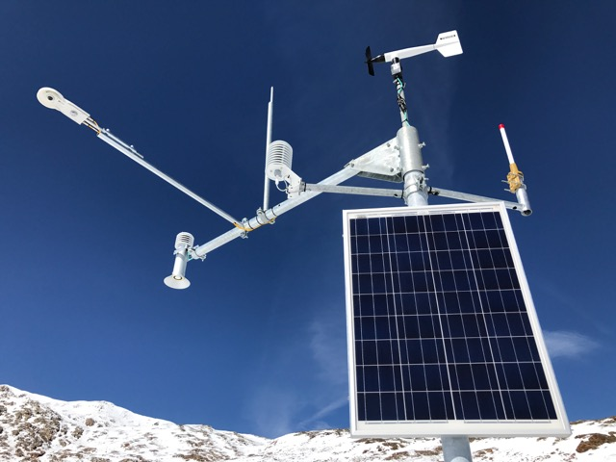
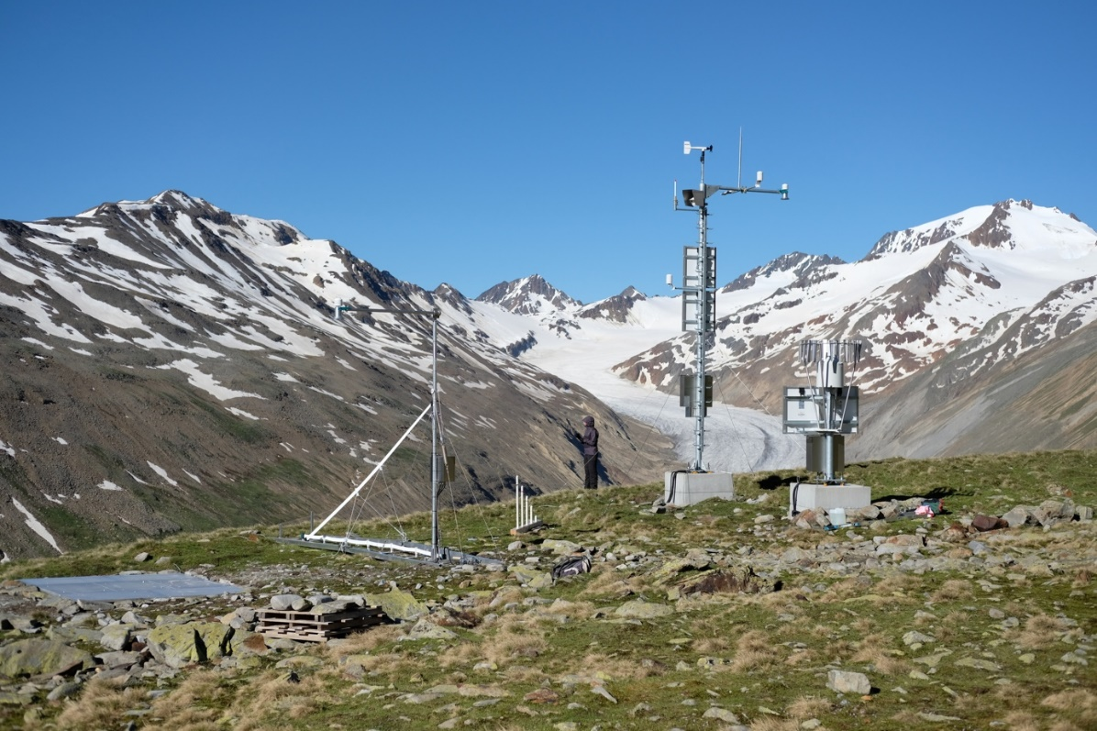
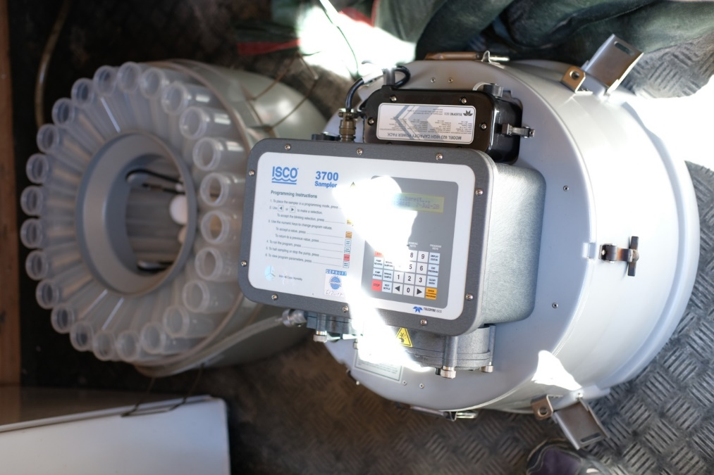
University of Innsbruck: Research team Human-environment systems research / Alpine Hydroclimatology (Prof. Ulrich Strasser, Dr. Michael Warscher)
Latschbloder (2919 m a.s.l.)
Proviantdepot (2737 m a.s.l.) with Hintereisferner and Weißkugel (3737 m a.s.l.) in the background
New installations in the Rofental High Alpine Research Basin, Ötztal Alps, Austria
ISCO water sampler at gauge Vent (1891 m a.s.l.)
Notes:
Latschbloder station (2919 m a.s.l.): this autonomous site representative for the typical areas getting ice-free is now also equipped with the same snow temperature profile sensor as the other sites.
Proviantdepot station (2737 m a.s.l.): this entirely new autonomous site has been brought into operation in fall 2019. It comprises sensors for temperature, humidity, wind speed and direction, air pressure, precipitation, radiative fluxes (short- and longwave, up and down), surface temperature, snow depth, snow water equivalent, layered density and liquid water content (snow pack analyzer).

Slide 17
Use of INARCH data in ESM-SnowMIP
A challenge for snow models as components of Global Earth Systems is bridging the scales over which site measurements are representative to the large scales of global model grid boxes (larger than 0.5° in all but a few models).
The 7138 Global Historical Climatology Network stations below show the network is sparse above 2500 m and the majority of stations in high elevation grid cells are located in valleys lower than the average grid elevation.
As alpine research catchments, several INARCH sites have hydrometeorological stations spanning a wide range of elevations within a small area.

Slide 18
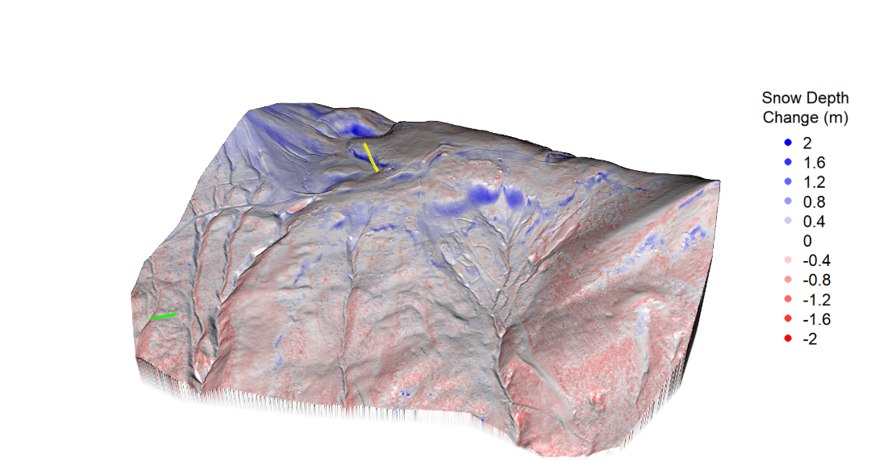
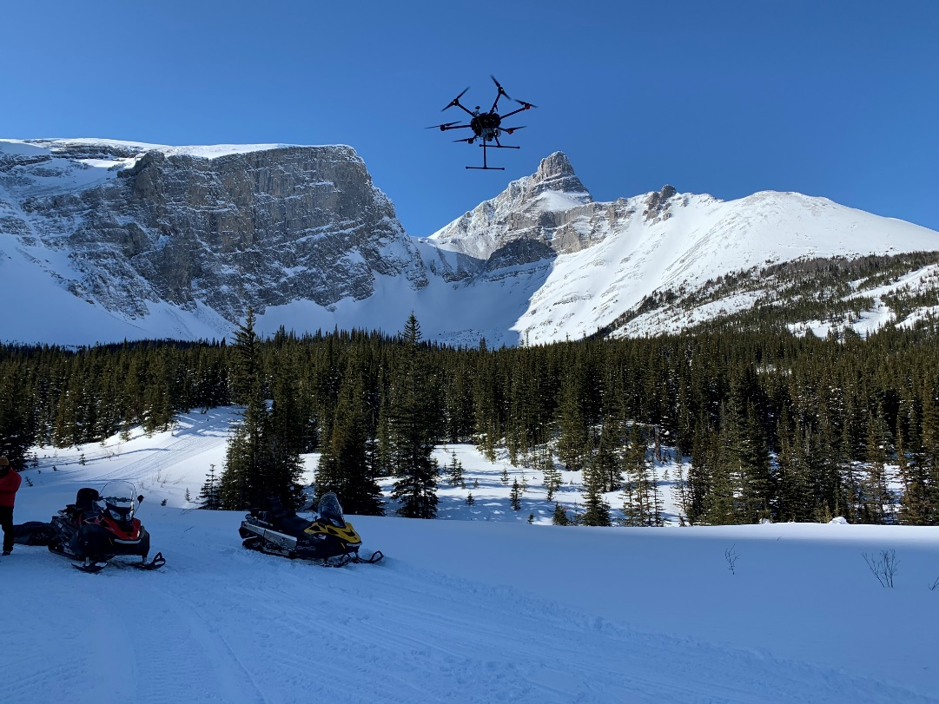
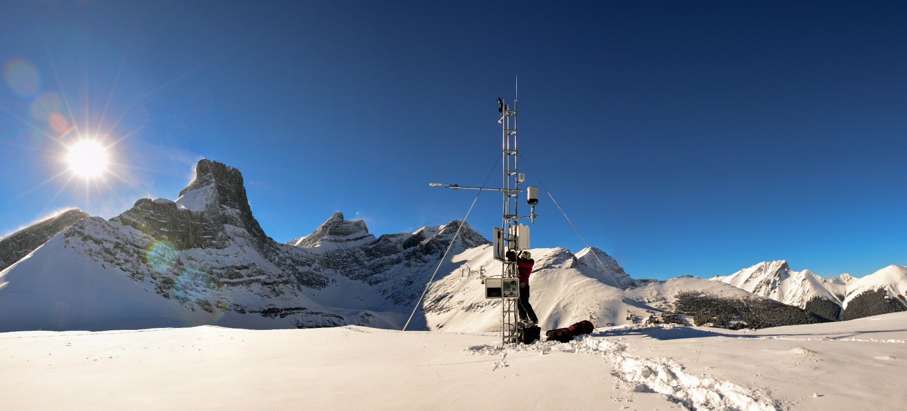
Canadian Rockies Hydrological Observatory
Snow Depth Change from UAV LiDAR
Fortress Ridge – Feb 13 to April 25, 2019
UAV LiDAR DJI M600 Pro Riegl miniVUX-1UAV
Fortress Mountain Snow Laboratory

Slide 19
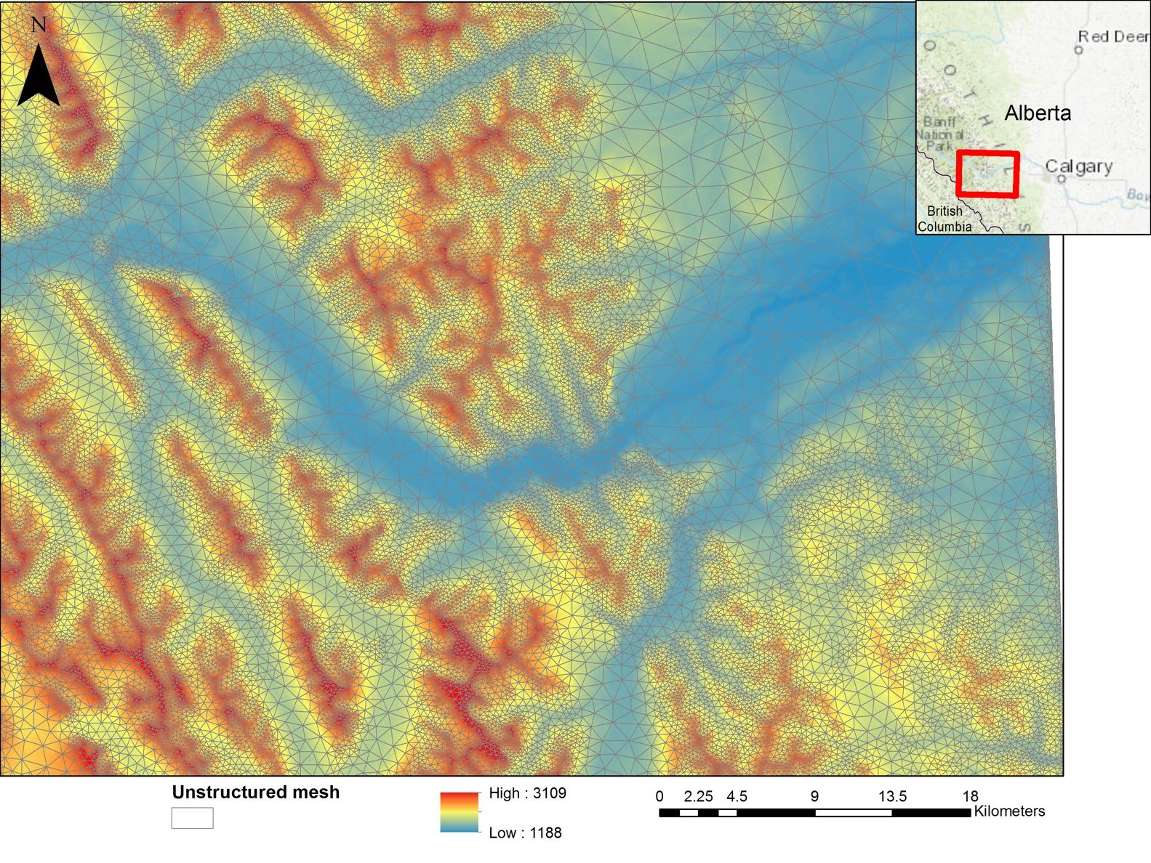
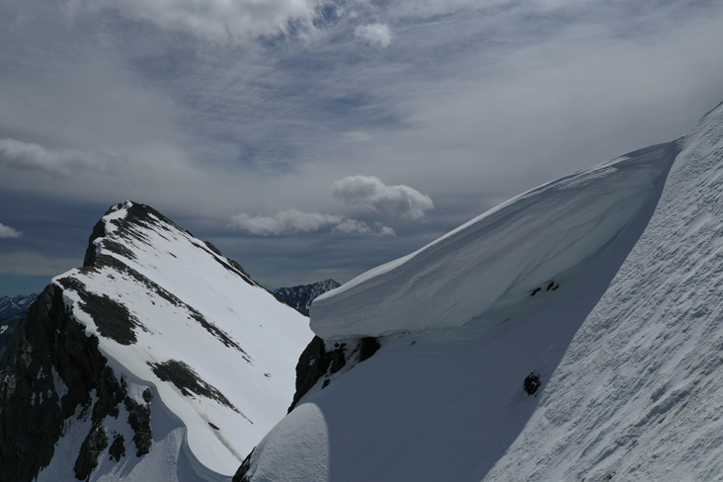
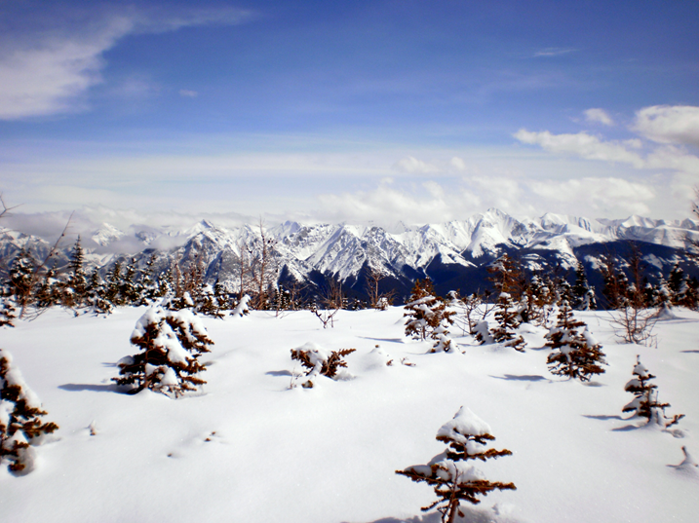
Canadian Hydrological Model (CHM)
Unstructured triangular mesh depending on topography and vegetation complexity
Flexible structure to test multiple hypothesis, assessment of uncertainty
Incorporation of existing code
Algorithms for downscaling meteorological data (e.g., from NWP)
Accounts for:
slope and aspect; terrain shading
gravitational redistribution
blowing snow (redistribution + sublimation)
snow/canopy interactions
Marsh et al. (2020 GMD)

Slide 20
Earth System Science Data Special Issue
Hydrometeorological data from mountain and alpine research catchments
https://www.earth-syst-sci-data.net/special_issue871.html
Guest Editors: J. Pomeroy, D. Marks, I. Lopez-Moreno
23 data papers contributed and more coming in
“Data sets contributed to the special issue should support and promote research on the effects of mountain snowpacks and glaciers on water supply as well as study of variations in energy and water exchange amongst different high-altitude regions. …The guest editors invite contributions of openly available detailed meteorological and hydrological observational archives from long-term research catchments at high temporal resolution (at least 5 years of continuous data with hourly sampling intervals for meteorological data, daily precipitation and streamflow, and regular snow and/or glacier mass balance surveys) in well-instrumented mountain regions around the world.”

Slide 21
Next Steps
Carry on in spite of COVID-19
Build linkages with other GEWEX cross-cuts and RHPs
US Water for Foodbaskets, Canada - GWF, ANDEX, TPE
Plan next phase of INARCH (when meetings are possible, we will reconvene and discuss the next steps and objectives moving on), and produce synthesis papers on key INARCH science topics and questions

